Slide 1
Feeding your Baby
An art that is learned together – day by day

Slide 2
At Frimley Health Trust around 80% of our mothers choose to breastfeed, here are some of the reasons why:
Your breast milk is perfectly designed for your baby
Breast milk protects your baby from infections and diseases
Breastfeeding provides health benefits for you
Breast milk is available for your baby whenever your baby needs it
Breastfeeding builds a strong and emotional bond between you and your baby which will last beyond the period of breastfeeding
Breastfeeding requires little equipment and can be undertaken anywhere
Formula milk does not provide protection from illnesses and does not give you any health benefits

Slide 3

This information package covers …
What makes breastfeeding so special?
Colostrum – the first milk
Breastfeeding and the microbiome
The first few days
How do I know feeding is going well?
Ideas for feeding positions
Expressing and storing your milk
Responsive feeding
Bottle feeding
What if baby comes early?
Partners and emotional wellbeing
Troubleshooting

Slide 4
Main Menu – Click the home icon to return to this page
Benefits of Breastfeeding
Off to the
Best Start
Positioning and Attachment
How to Know if Feeding is Going Well
Expressing
Bottle Feeding
What if Baby Comes Early
Troubleshooting
Partners Families and Emotions

Slide 5
Why is breastfeeding so special?
Did you know?
If you come into contact with germs, your milk will contain antibodies for these germs and pass them to baby in your milk.
If your baby comes into contact with germs, her saliva sends messages to your body to make the right antibodies for the germs, so your milk can deliver them to her!
WOW!
Breast milk is considered a ‘live’ fluid’ – it changes from hour to hour!
It contains hundreds of nutrients which cannot be replicated in formula
These special factors help to enhance and protect your baby’s development

Slide 6
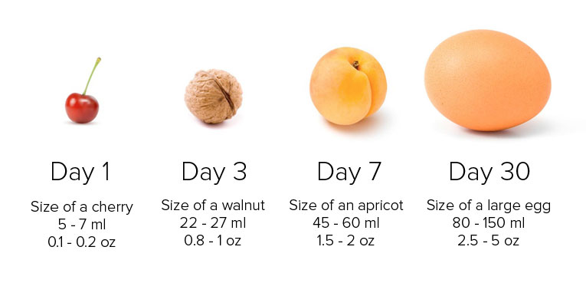
Colostrum – a super food!
Colostrum is the milk you make for baby in the first few days after birth. It is in tiny volumes, because baby’s tummy is tiny!
Colostrum is ↑high in protein, ↓low in fat, and easily and quickly digested. Perfectly tailored for your baby’s brand new digestive system.
Remember this picture when your baby is feeding very frequently. Easily and quickly digested means more meals!
Breast feeding is more than just food, it is a source of comfort and safety to baby, so your baby will feed to feel happy too.
Think of colostrum as baby’s first vaccination: it is packed full of ‘good’ bacteria to help protect your baby

Slide 7

The microbiome and your milk
Remember we said colostrum is full of good bacteria?
Part of its job is to coat baby’s gut in a protective layer to keep out harmful bacteria
The ‘Microbiome’ is the special environment in your baby’s gut which helps the good bacteria to thrive
Breastfeeding helps to kickstart your baby’s immune system by building the microbiome, and helping to protect her from illnesses and disease

Slide 8
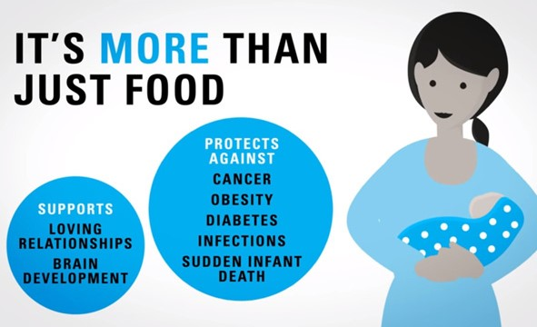

This powerful protection is unique to breast milk and cannot be replicated by formula
Every drop of breastmilk counts! It’s more than just food…
BFI unicef.co.uk

Slide 9
What is in breastmilk?
Human milk
All the additional aspects of breastmilk are live factors that cannot be replicated in formula. Your breastmilk changes feed by feed and day by day, adapting to the needs of your baby
CYTOKINES
IL-7
ENZYMES
MILK LIPIDS
OLIGOSACCHARIDES
LACTOFERRIN
LEUKOCYTES
IMMUNOGLOBULINS
Formula
STEM CELLS
LYMPHOCYTES
GROWTH FACTORS
VITAMINS & MINERALS
VITAMINS & MINERALS
FATS
FATS
CARBOHYDRATES
CARBOHYDRATES
PROTEIN
PROTEIN
WATER
WATER
Notes:
This slide lists the key ways in which the constituents of breastmilk or human milk work to protect infant health. NB: This information needs to be explained thoroughly if the slide is to be effective.
Key points
The important thing to point out is that even the basic nutritional constituents vary greatly between human milk and infant formula. Breastmilk contains many more live constituents that promote health.
Water: We are very lucky to have access to clean water in UK, but occasionally climate issues like floods, accidental over use of cleansing products, or fluorine can sometimes contain contaminants. Breastmilk water is filtered at source.
Protein: Protein in breastmilk is more whey based (60-80%) and easier to digest and the main protein, alpha lactalbumin, which makes up 20% of the total protein, has been associated with the destruction of over 40 types of cancer cells including bladder and brain. Protein in formula (cows’ milk protein) has been associated with an increased risk of a baby developing juvenile onset diabetes.
Carbohydrates: Lactose is the primary carbohydrate in breastmilk and provides around 40% of the total calories. Lactose is also more prevalent in UK formula but you may also see sucrose, fructose and glucose in some soya or lactose free formula.
Fats are essential for brain development and absorption of fat soluble vitamins, and are a major calorie source. The long chain polyunsaturated fatty acids (LCPs) which naturally occur in breastmilk support the development of the entire nervous system including retinol development (improved eyesight) and there is some evidence of a link to improved IQ. Fats in formula tend to change depending on the market – currently they are mainly vegetable such as rapeseed oil, sunflower oil, coconut oil and algal oil, but some contain egg (egg phospholipid anhydrous milk fat) or fish oil.
Vitamins and minerals are essential for the health of our bodies from healing wounds and supporting bone growth to bolstering the immune system. In formula milk extra vitamins and minerals are added to the powder to ensure they are sustained for the entire shelf life (six months to a year), so amounts will vary accordingly.
Growth factors: Epidermal, insulin and transforming factors which promote gut growth. The epidermal growth factor is higher in the milk of mothers who have preterm babies, and it is linked to a reduction in Necrotising Enterocolitis (NEC) and other inflammatory responses. There is some evidence that growth factors also play a role in early life programming and so may be associated with a reduced risk of obesity and cancer in later life.
Transfer factors enable effective absorption of nutrients in the milk e.g. lactoferrin, which assists with the absorption of iron, and in so doing reduces the amount of free iron which attracts bacteria. Lactoferrin is also bactericidal e.g. it kills E.coli bacteria. There are also transfer factors that help with the absorption of fats and vitamins.
Stem cells: an internal repair system – these cells have the ability to develop into many different cell types. There is some evidence that these cells remain in the system long after breastfeeding has stopped. Scientists are looking at their potential for treating conditions such as leukaemia, diabetes, spinal injuries and Parkinson’s.
Immunoglobulins: IgA, IgG, IgM and IgD, the most important is IgA, which provides a protective coating to the baby’s gut; it covers the mucosal gut surface to prevent entry of pathogenic bacteria and enteroviruses (E Coli, Salmonella, Streptococci, Staph, pneumococci, rotavirus etc.), protecting against gastroenteritis, respiratory infections etc. Please see slide 11 for an explanation of how a mother provides up to date antibodies to her baby.
Leukocytes destroy harmful bacteria. One type, called macrophages, also produce lysozyme, an enzyme which destroys bacteria by disrupting the cell wall.
Oligosaccharides: More than 200 types of simple carbohydrates are found in breastmilk. These influence the development of the microflora by increasing the number of beneficial bacteria found in the baby’s gut and in so doing they protect the baby against infections e.g. otitis media, respiratory, urine and gastrointestinal.
Milk lipids damage the outer surface of certain virus types, reducing infection rate in the baby.
Enzymes aid digestion and absorption and some destroy bacteria.
IL-7 is linked to the size of the thymus which is a central organ in the immune system. Breastfed babies have a much larger thymus than formula fed babies, which demonstrates a stronger immune system. IL-7 also has a role in stimulating antibody producing cells. It is also considered to play a part in reducing the risk of childhood leukaemia.
Cytokines: Another important constituent for boosting immune system.
There many more constituents and we are learning more every day We are just scraping the surface here but for more information please see this advertising campaign for breastmilk: “Human Milk, Tailor-Made For Tiny Humans”: https://vimeo.com/190696865

Slide 10

Click below to watch a short video on just how special your milk can be!

Slide 11


Building a happy baby!
REALITY
When babies are comforted and their needs are met, they grow into calmer and more confident individuals
Young babies cannot learn routines. They have only ‘needs’ rather than ‘wants’; responding to these needs makes for happier babies, which is easier for parents!
MYTH
Babies become spoiled or clingy if they are held too much or given too much attention
Getting babies into routines is important and easier for parents
Click the picture here to view this informative leaflet

Slide 12
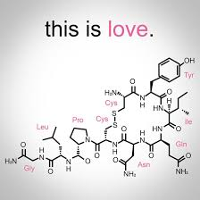
The role of Oxytocin- the love hormone
Newborn babies have a strong instinct to be close to their parents; this closeness helps them to feel safe, secure and loved
When babies feel safe, secure and loved, their levels of a hormone called oxytocin increases (the same happens for their adults too!)
This is why babies may seem unsettled when we try to ‘put them down’. Cuddling your newborn as much as they need will not spoil them, but rather make them feel safe and loved, increasing their oxytocin levels
This does wonders for their chances of breastfeeding calmly and successfully.

Slide 13

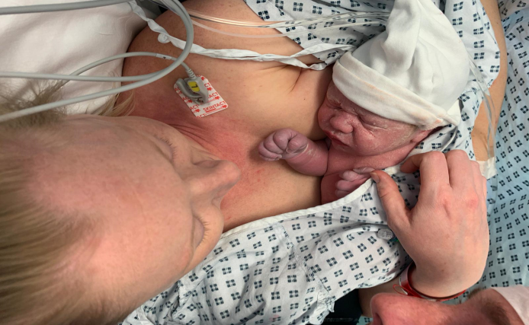
Lets get started…
The Golden Hour
In the first hour after birth, your levels of the happy hormone oxytocin are high.
This hormone helps to facilitate instinctive feeding behaviours for both mum and baby- there are 9 instinctive stages at birth.
Skin to skin and early feeding helps your milk production too!
Ask your midwife for help with feeding baby as soon as you feel ready following delivery.
So far, we have learned lots of reasons why breastfeeding is amazing.
Now let’s talk about how it all starts!
Babies are born primed and ready to feed.
Uninterrupted skin to skin contact as soon as possible following birth is key to getting your breastfeeding journey off to a good start.

Slide 14

Skin to skin for all babies
All babies deserve to be welcomed to the world with immediate skin to skin at birth. Holding your baby in close contact, skin-to-skin, as soon as possible after birth will help you get to know your baby and can be enjoyed for many months to come. This can be achieved whether or not you have a normal birth or a caesarean section.
Why is skin-to-skin so important?
Initiates a close and loving relationship between you and your baby.
Regulates your and your baby’s temperature, heart rate, breathing and keeps your baby safe.
Helps your baby’s brain development.
Colonises your baby with friendly bacteria from you, your partner and the environment, which will protect and enhance your baby’s long term gut flora.
Reduces stress hormones.
Stimulates feeding behaviour and if you are breastfeeding it will boost your milk supply.

Slide 15

9 Instinctive Stages at Birth
Birth Cry: The distinctive cry occurs immediately after birth to expand lungs
Relaxation: The newborn relaxes and there are no mouth movements. Keep baby skin to skin.
Awakening: The baby begins to move head and shoulders at about 3 min old. Opening eyes and mouth activity.
Activity: Increases mouth movements and rooting. At 8 minutes old
Crawling: Moves towards the breast in short bursts, usually beginning at 35minutes old.
Resting: Will rest between periods of activity.
Familiarisation: Will begin to lick nipple and massage breasts it usually starts at 45 minutes old and lasts approx 20 minutes
Suckling: About an hour after birth the baby will try to self attach and start suckling.
Sleeping: At approx 2 hours old will fall into a restful sleep.

Slide 16
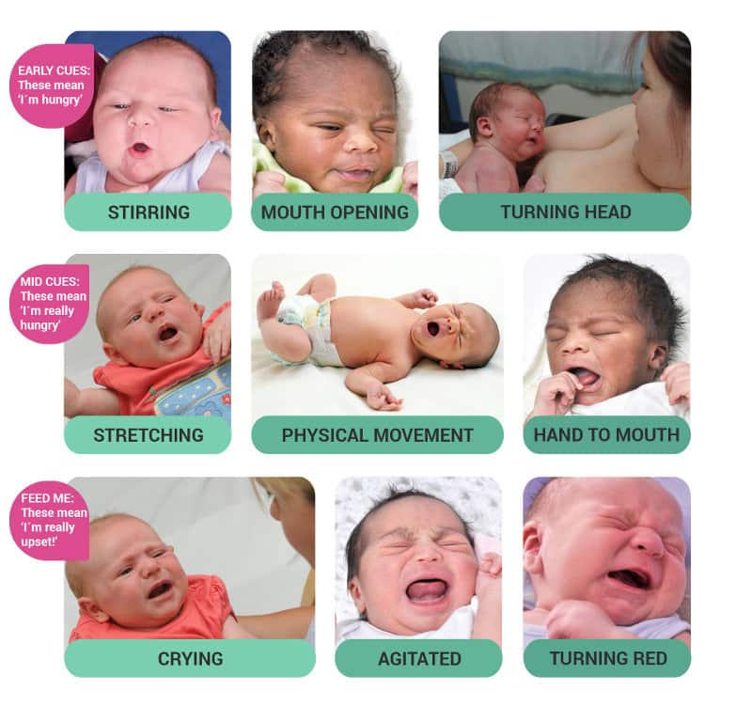
Feeding cues
It’s important to know how to recognise when your baby is hungry
There are subtle behavioural changes babies make to let you know when they’re getting ready to feed.
Observing your baby for these feeding cues will help to establish effective feeding and a healthy milk supply.
We encourage responsive feeding. This means responding to your baby’s needs for food and comfort but also responding to your needs. If your breasts are full or you just need a rest and cuddle with your baby. Typically babies breastfeed at least 8 -10 times per 24 hours.
Top tip: as much skin to skin contact as possible will make it easier
to get to know your baby’s needs

Slide 17
How to hold your baby for feeding
There are many different positions in which to hold your baby while they feed; it will take time and a bit of trial and error to find which positions work best for you both.
However, the principles of good attachment are the same no matter which position you choose
Just remember…
CHIN!

Slide 18
CHIN – a guide to good positioning and attachment
C – close to Mum
Baby is held nice and close to you.
H – head free
Mum’s hand supports baby’s shoulders/neck, not head. This is important as it allows your baby to tilt their head back as they come to the breast.
I – in-line
Baby’s head, shoulder and hips are all in a straight line so swallowing is easier.
N – nose to nipple
This allows for a deep attachment when baby opens their mouth wide.
Top Tips:
It’s important to make sure you are in a position which is comfortable and sustainable for the feed.
Use pillows and cushions to support your arms if needs be.
Be mindful of your shoulders/back: bring baby to your breast, don’t move your breast to your baby!

Slide 19
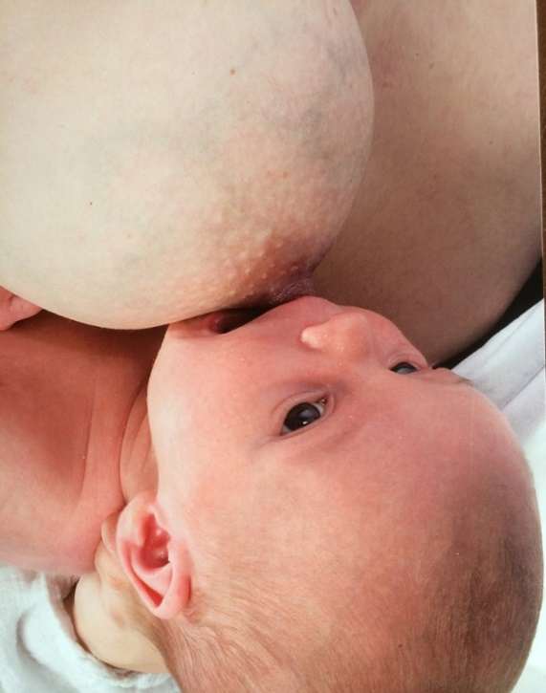

In this picture the Mum’s hand is supporting behind the baby’s neck, allowing his head to be free to tilt back as he opens his mouth nice and wide to attach to the breast.
Note that the top lip is opposite the nipple and the lower jaw has dropped down ready to take a mouthful of breast tissue below the nipple.
Here you can see baby’s cheeks are full and round, her chin is pressing into her Mum’s breast tissue, and there is a slight gap between the breast and baby’s nostrils. These are all signs of good positioning

Slide 20
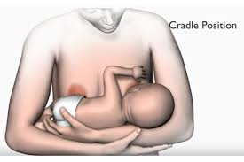
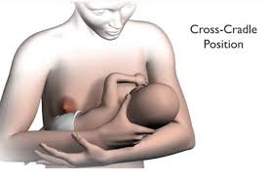

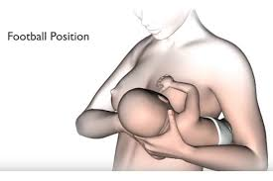

Different positions you could try
The laid back position allows baby to use their natural, inbuilt instincts to seek out the breast. It can be such a relaxing and comfy position for both you and baby.

Slide 21




Positions to try if you have twins or more
Some mothers of twins or triplets may choose to feed babies individually initially and then work on tandem feeding once they have gained confidence with positioning and attaching. These are just a few positions that may work when you are trying to feed two babies at once. For more information see the Twins trust.
https://twinstrust.org

Slide 22

How you position your baby is important for your comfort and for your baby to feed effectively at the breast.
Click here to see positioning and attachment demonstrated beautifully by one of our Mums and her baby

Slide 23
How will I know if things are going well?
Your midwife will ask certain questions which help to establish if feeding is going well for both mum and baby.
When babies are breast fed, we cannot see ‘how much’ they are getting in any particular feed, so the questions we ask help us to determine effective feeding in other ways.
Many new parents worry about the amount of breastmilk their babies may be receiving, so please do always seek advice if you have concerns that your baby may not be getting enough milk.
Often however, the cause of the concern can be explained by very normal newborn feeding behaviours. We will address these in a bit…

Slide 24
These points indicate feeding is going well!
Your baby should be feeding a minimum of 8 times in 24 hours (the gap between these feeds will vary)
Your baby should generally be calm and relaxed at the breast (this may be after a few minutes of fussing and head-bobbing to begin with though!)
Breastfeeding should be comfortable for the Mum; there shouldn’t be any feelings of sharpness, stinging or pulling beyond the first 30 seconds or so (it may feel strong)
From about the third day onwards, you should be able to hear baby swallowing frequently throughout the feed. Babies often swallow after every 2-3 sucks

Slide 25
These points may indicate a problem or a need to speak to your Midwife/Health Visitor
If your baby is overly sleepy and has fewer than 6 feeds in 24 hours
If your baby is at the breast for longer than 40 minutes at every feed
If your baby comes on and off the breast and is unsettled throughout the feed
If you are having pain in your breasts or nipples which doesn’t resolve within the first 30 seconds or so, and/or if your nipples are misshapen or pointed after a feed
If you cannot tell if baby is swallowing
If you have any worries that your milk is not enough or that baby
may need a dummy or formula

Slide 26
What goes in, must come out!
Baby’s nappies tell us a great deal about how they are feeding
Wet nappies increase with each day in relation to increasing milk supply
Dirty nappies change with each day as breastmilk helps to clear the large intestine of meconium (baby’s first poo)
Day 0-1 – 1 or more
Day 1-2 – 1-2 or more
Day 3-4 – 3 or more,
getting heavier
Day 5 onwards - 6 or more,
noticeably heavy
Day 0-1 – at least one, meconium
Day 1-2 – 1 or more, meconium
Day 3-4 – 2 or more, turning lighter
Day 5 onwards - 2 or more yellow stools

Slide 27
To summarise, here is a discussion about feeding between a Midwife and a Mum to a 3-day old baby
Mum reports the baby is going to the breast between every 1½ -3 hours, feeding for between 5 and 40 minutes at a time
She says the feeds feel strong, but not painful, after the first 20 seconds or so of the baby attaching
Following each feed, the baby comes off the breast spontaneously and Mum’s nipples are rounded in shape
The baby is having around 3 or 4 wees in 24 hours, and her poos are turning brow/green
From all these observations, we can assume that baby is effectively feeding at the breast without ever needing to see ‘how much’ she is taking in at each feed!

Slide 28
Expressing – these are just a few reasons you may need to or choose to express your milk
Before your baby is born- especially if you have risk factors such as Gestational Diabetes. This is known as antenatal colostrum collection or colostrum harvesting. See the link to our leaflet for more information on this.
Click here for our leaflet about antenatal colostrum
In the first few days- Sometimes baby’s can be very sleepy and reluctant to feed in the first day or two. If your baby is like this then we would recommend lots of skin to skin contact and encourage you to hand express every 2 – 3 hours. This stimulation will encourage your milk supply so that when baby is more ready to feed the supply will be increasing and ready to meet their needs too. Any colostrum you get can be given to your sleepy baby and this can then give them the energy to wake and feed.
If you are separated from baby- For example baby is on the Neonatal unit (NNU). We encourage mum’s to initiate expressing within 2 hours of birth if their baby is transferred to NNU.
What if baby comes early?
To relieve engorged breasts or relieve blocked ducts.
Engorgement or full breasts?

Slide 29
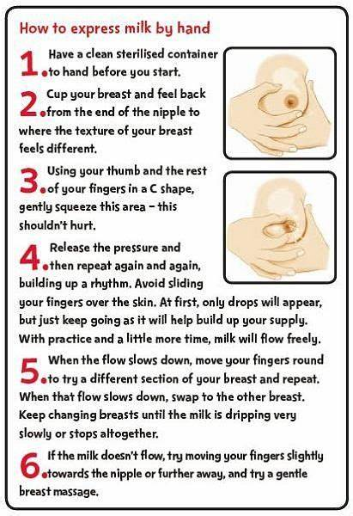
Hand Expressing
In the first few days your breasts will produce colostrum. This is small volumes of concentrated nutrition, perfectly tailored to the needs of your newborn and their small tummy.
Hand expressing is the preferred method for collecting your colostrum, this is to ensure that you are able to collect every last drop and not lose some within the tubing of a breast pump.
Some women may choose to try collecting colostrum by hand expressing towards the end of their pregnancy - 36 weeks gestation onwards.
Speak to your Midwife for support and guidance with learning this new skill.
Click here to view the
“Off to the Best Start” Leaflet

Slide 30

Video from Unicef to demonstrate hand expressing

Slide 31

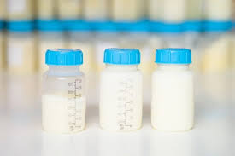

Storage of Breastmilk
Fresh Breastmilk including colostrum
Room temp: 6 hours
Fridge 5-10°C: 3 days
Fridge 4°C or lower: 5 days
Freezer -18­°C: 6 months
For more information see the
Breastfeeding Network information leaflet on expressing and storing breastmilk.
Click here

Slide 32
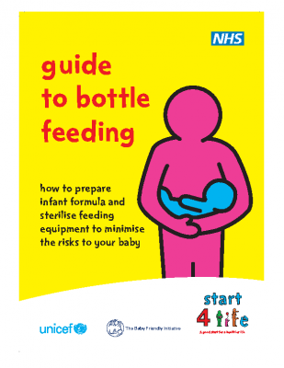

Bottle Feeding
If you choose to bottle feed expressed breastmilk or formula, there are a few things you will need to know.
Skin to skin is so beneficial and important for you and your new baby.
Equipment you will need:- Bottles, teats and bottle covers, bottle brush and sterilising equipment.
If using formula you will only need
First infant milk for the first year
Click the picture to view
Click the picture to view

Slide 33
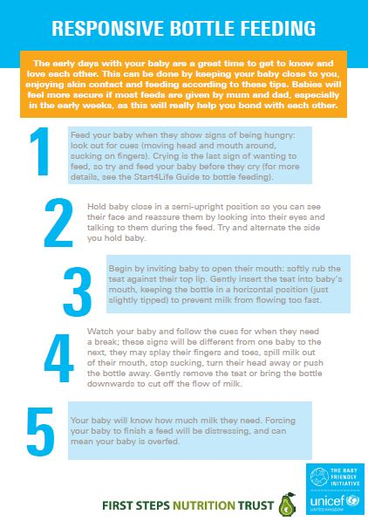
Responsive and paced bottle feeding
Whether you are bottle feeding expressed breastmilk or artificial formula milk, it is important to offer feeds responsively, following your baby’s feeding cues.
If you follow the guidance for paced bottle feeding you will avoid over feeding your baby from the bottle.
If you are combination feeding from the breast and bottle, then paced bottle feeding enables your baby to feed at a similar pace to how they feed at the breast. You will notice that they take pauses in their sucking and drinking to allow them to breathe and take the feed calmly.

Slide 34
Sterilising Before sterilising always wash well with hot soapy water and then rinse
Steam sterilising
Follow manufacturers instructions
Make sure opening of bottles and teats are facing down.
Cold-water sterilising
Follow manufacturers instructions
Change solution every 24 hours
Equipment should be in solution for at least 30mins
Keep all equipment under solution with floating cover
Sterilising by boiling
Ensure hot water safety to avoid scalds or burns
Make sure the equipment is safe to boil
Boil I water for at least 10mins.

Slide 35
Infant Formula
First Infant Formula is what is recommended for the 1st year.
‘Hungry milk’, ‘second milk’, ‘toddler milks’ and ‘growing milks’ are not necessary or suitable for babies, they can be much harder for your baby to digest.
For more unbiased information on different milks and food sources please visit
www.firststepsnutrition.org
Most infant formula is made from cow’s milk that has been treated to be suitable for babies. You should not feed other formulas unless discussed with the Midwife, Health Visitor or GP.
There are 2 forms
Ready- to- feed, sold in cartons and sterile (this we would recommend to bring into hospital if you plan on bottle feeding)
Powdered infant formula- not sterile.

Slide 36

Making up a feed
Video from Bolton NHS Trust for making up feeds and paced feeding

Slide 37
What if baby comes early?
A baby born before 37 weeks of pregnancy is called a premature baby and depending on how early your baby is born may need to be looked after in the Neonatal Unit (NNU).
The health professionals understand how important it is to support families during this emotional time and will support you to become involved in the care of your baby as soon as you are ready.
Being involved in your baby’s care helps you to bond with your baby and helps your baby’s progress and development.
You will be informed about the benefits of breast milk for your baby …

Slide 38






The benefits of breast milk for your premature baby
Immunity
Colostrum is rich in antibodies helping to protect your baby from bacteria, viruses and life-threatening infections
Brain Development
Ingredients found in breast milk boost brain growth and development
Easy to Digest
Fats and enzymes present in breast milk mature the gut and helps babies progress more quickly to full feeds
Closeness
Providing your breast milk is something only you can do for your baby and helps you to become involved in their care
Optimal Nutrition
Nutritional components are highly concentrated in colostrum and your milk adjusts to suit the needs of your baby
Growth
Together all the benefits of breast milk promote your baby’s growth and development

Slide 39


Every drop counts
Early
Express within the first 2 hours
after birth
Frequent
Express 8-10 times in 24 hours
including at least once at night
Expressing early and frequently is crucial to ensure you maximise your
milk production so that you can maintain your supply for as long as you wish

Slide 40
Love matters
Your baby will be familiar with your voice and your smell which will comfort them so talk to them, read to them and sing to them
You will be able to hold your baby frequently in skin to skin contact as soon as you and baby are well enough – this has lots of benefits for you and baby……
Helps regulate baby’s heart rate and breathing
Maintains baby’s temperature control
Reduces Mum and baby’s stress levels
Boosts Mum’s breastmilk supply
Bonding with your baby will enhance their physical and emotional wellbeing

Slide 41

Partner and family support
Becoming new Parents is beautiful but it can be overwhelming at times.
Breastfeeding is a team effort, Partners and family can support you in many different ways.
Your partner can be gate keeper and keep visitors at bay.
Ensure you have everything in arms reach when feeding – drinks, food, TV remote, phone.
Partners and family can bond by meeting baby’s other needs- nappy changes, bathing, comforting through rocking and singing, walks while Mum rests.
Siblings can bond by helping Mum or making gifts for baby, being involved with bathing, cuddles and interacting with baby.

Slide 42

Emotions
A new baby can bring joy and happiness but also at times exhaustion and anxiety.
Baby Blues- this occurs in the first few days after birth due to hormone changes, it may include mood swings, tearfulness and anxiety. This is normal and is usually short lived.
It can also be normal to have good days and bad days, be open about how you are feeling and talk to your partner or someone close to you, especially if you are feeling there are more bad days than good days.
Partners can also feel overwhelmed and support is out there for them too.
Speak to a health professional if you feel you could benefit from further support,
we are here to help, you are not alone.

Slide 43




Support available
Talking Therapies
0300 365 2000
talkingtherapies@berkshire.nhs.uk
0808 1961 776
www.dadsmatteruk.org
www.mind.org.uk

Slide 44
Troubleshooting
Breastfeeding is an art learnt together day by day, it is common to face challenges along your journey.
These are some of the more common challenges and some tips to help overcome them..
Sore Nipples
Tongue tie
Jaundice
Weight loss
Mastitis
Thrush
Engorgement
Getting support early on is crucial so tell your Midwife/Health Visitor
about any concerns or worries you have.

Slide 45
Sore Nipples
Many Mothers experience sore nipples at some point in their breastfeeding journey.
Breastfeeding should be pain free
The most common cause for sore nipples is shallow attachment.
Deep attachment is key for effective milk transfer and comfortable feeding please see the positioning and attaching slide and ask your midwife to observe a feed to help you improve this positioning.
Sometimes nipple soreness with good position and attachment can be due to tongue tie.
Nipple shields have their use but please get advice for your Midwife or Health Visitor before using them as they are never the answer to alleviating sore nipples

Slide 46

Tongue tie
Tongue tie is where the strip of membrane that connects the tongue to the base of the mouth is shorter than normal and may cause restricted tongue movement
Referral for division can be made following review by the infant feeding team which includes assessment of tongue movement and observation of a breastfeed
Some symptoms of tongue tie can be:-
difficulty attaching/ slipping off frequently
ongoing soreness despite good position and attachment
increased weight loss/ slow to gain weight; recurrent mastitis
Approximately 10% of babies can be born with tongue tie, but of these, only 2-3% of them may need dividing due to impacting how the baby is able to feed.

Slide 47

Jaundice
Babies more at risk are:
Preterm babies
Low birth weight
Instrumental deliveries
Physiological Jaundice is a natural condition in which excess red blood cells required by baby in utero are no longer needed.
As they are broken down they produce ‘bilirubin’ and this product is what can make baby’s look yellow.
Jaundice is usually harmless and can be rectified with frequent feeding resulting in frequent stooling to expel bilirubin.
If a baby feeds infrequently it can reabsorb the bilirubin resulting in sleepy baby’s who are reluctant to feed and rising bilirubin levels which may need treatment such as phototherapy.

Slide 48

Weight Loss
The feeding plan should be temporary to allow baby to catch up and will need to be reviewed with your community Midwife after reweigh at 48 hours.
In some cases you may need to be re-admitted to hospital for baby and feeding to be fully assessed and support with the feed plan.
Your baby will be re-weighed on Day 5 and approx. Day 10 by your Midwife.
It is normal for a baby to lose up to 8% of their Birthweight on Day 5 but your baby should be back to birthweight by 2 weeks old.
If weight loss is >10%, it is vital the feed is assessed by a healthcare professional and a feed plan put in place.
It may be necessary at this point to incorporate pumping and topping up with expressed breastmilk or formula post breastfeeding for a few days.

Slide 49
Engorgement or full breasts?
Fullness
Engorgement
Self help for both
Frequent and effective feeding
Warm/ cold compresses
Massage when feeding or pumping
Savoy cabbage leaves against breasts
Breasts are: warm, firm, tender, heavy
May show marbling
Milk flows readily
No Fever
This is normal, continue to feed responsively and your supply will adjust to your baby’s needs.
Breasts are: Hot, hard/tight, Painful, oedematous/shiny
May be inflamed, red
Milk not flowing
May have fever for 24 hours
This is not normal- discuss with your Midwife or Health Visitor

Slide 50

Mastitis
For more information on managing mastitis
To view the Breastfeeding network information leaflet
Mastitis is an infection
If engorgement goes untreated it can lead to mastitis.
Symptoms:- Flu like symptoms
High Temperature (38c or greater)
Red, painful lumpy area of breast
Whole breast may feel sore or tender
Treatment:- Keep milk moving by feeding or pumping
Check attachment with a health professional.
express after feeds if breasts are not feeling softened from the feed.
change position so that baby’s chin is placed by affected area to drain this area.
Analgesia.
If not improved within 12 hours or fever develops then you will need antibiotics
Click here

Slide 51
Thrush
Treatment
Symptoms
Crucial to get attachment checked as thrush is often mistakenly diagnosed when it is ineffective attachment, Seek help from infant feeding specialists.
Mother and Baby should be treated simultaneously, GP can prescribe appropriate anti-fungal therapy.
Hygiene- hot wash towels/ reusable breast pads/ bras, hand washing.
Do not store expressed breastmilk in active thrush period.
Sudden breast/nipple pain in both breasts after previous pain free feeding. This can last beyond feeding period.
Shiny red appearance of nipple/areola or white nipple.
In Baby’s mouth there may appear white spots on gums, cheeks, tongue.
For more information on
treating and managing thrush
To view the Breastfeeding network information leaflet
Click here

Slide 52
Thank you
We hope this presentation will be beneficial on your new exciting journey.
We are always here to help.
Infant Feeding Team,
Frimley Health NHS Trust

