Slide 1

    How to complete a ReSPECT form
Use and completion of ReSPECT form
for a child or baby
A step-by-step guide
ReSPECT — child or baby (version 1.0)

Slide 2
    The role of a ReSPECT form for a child or baby
There are several possible scenarios:
As a universally recognised document completed as an adjunct to an advance care plan to
▫ flag the presence of a more detailed advance care plan
▫ provide a summary of the elements of the detailed plan,
relevant to emergency care
As a document to recommend treatment that should be considered in an emergency
As a record of a medical management order made by the courts
ReSPECT — child or baby

Slide 3
    When to complete a ReSPECT form
During or immediately after the completion of an advance care planning process
When a baby or child is known to need specific treatment in an emergency
As a stand-alone document in an acute situation:
follow the ‘ReSPECT process’, which we will discuss shortly
After a decision regarding limitation of treatment is issued by the courts
ReSPECT — child or baby

Slide 4
    Professionals who may refer to a ReSPECT form
Ambulance crews
Doctors (all settings and grades)
Nurses (all settings and grades)
Allied health professionals (all settings and grades)
Social care professionals
Remember:
Always consider the likely users
Ensure that recommendations will be clear and unambiguous to all potential readers
ReSPECT — child or baby

Slide 5
    Using ReSPECT to guide discussion about CPR
    or other life-sustaining treatment
Begin with a conversation with the child’s parent(s)
Involve all those with parental responsibility whenever possible -
If this is not possible record why
Make only the critical treatment decisions that are needed for immediate care
If time allows, use the advance care planning process and use discussions to complete a ReSPECT form
If no discussion is possible, record the reasons
ReSPECT — child or baby

Slide 6
    ‘Terminology’
In the slides that follow:
                reference to ‘parent’ means to anyone with parental responsibility
ReSPECT — child or baby

Slide 7
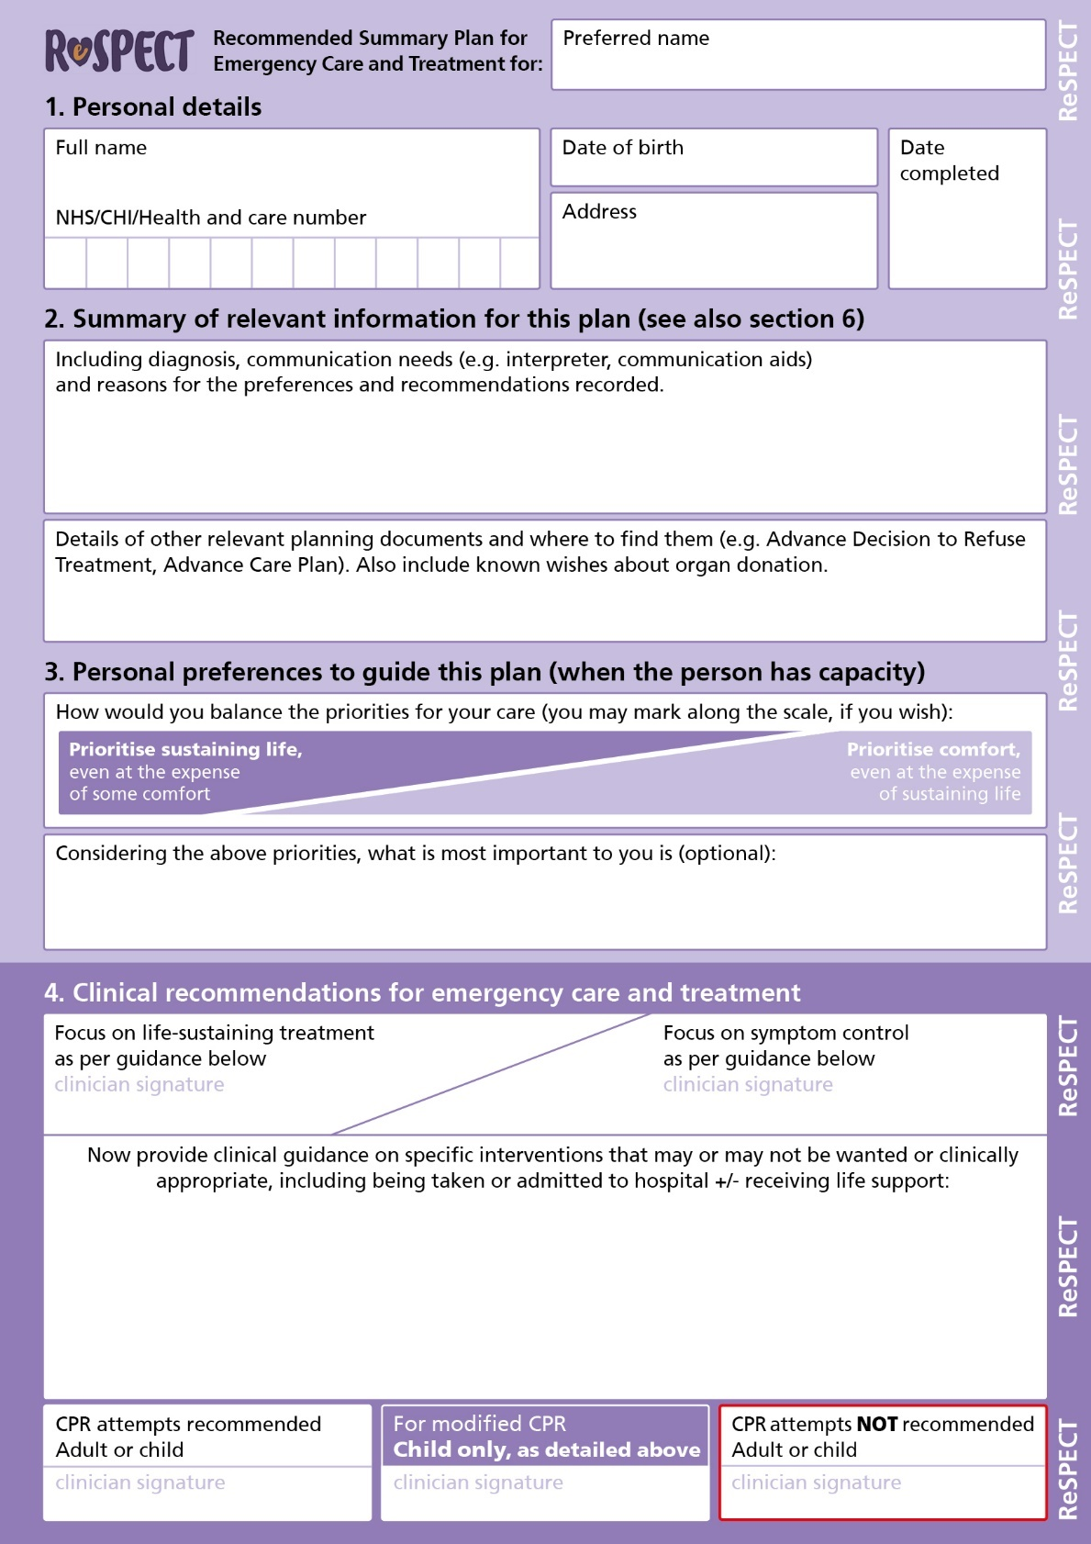
    How to initiate ReSPECT
The ReSPECT form may be used to support discussions with parents (but does not have to be used for this)
It is designed to guide conversation, by working through and completing each section in sequence
ReSPECT — child or baby

Slide 8
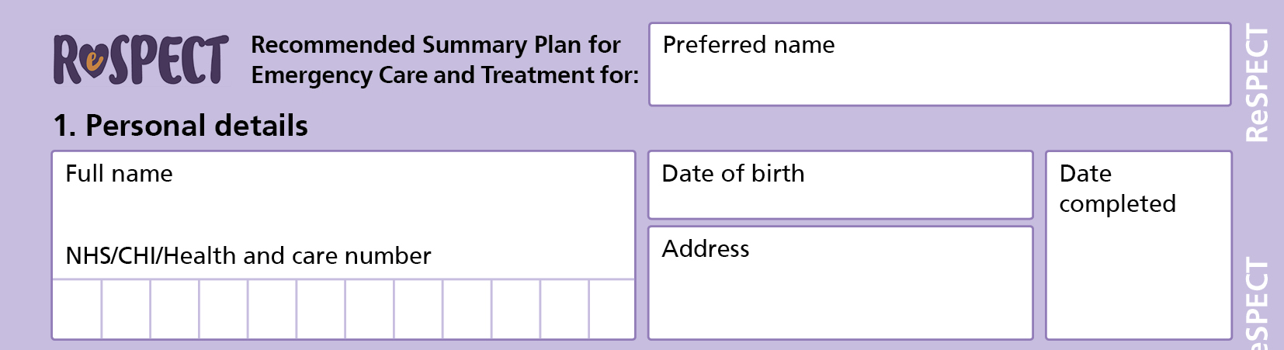
    Completing a ReSPECT form – 1
Write legibly!
Insert the child’s preferred name
Insert the child’s full details
Insert the date of completion of the form
ReSPECT — child or baby

Slide 9
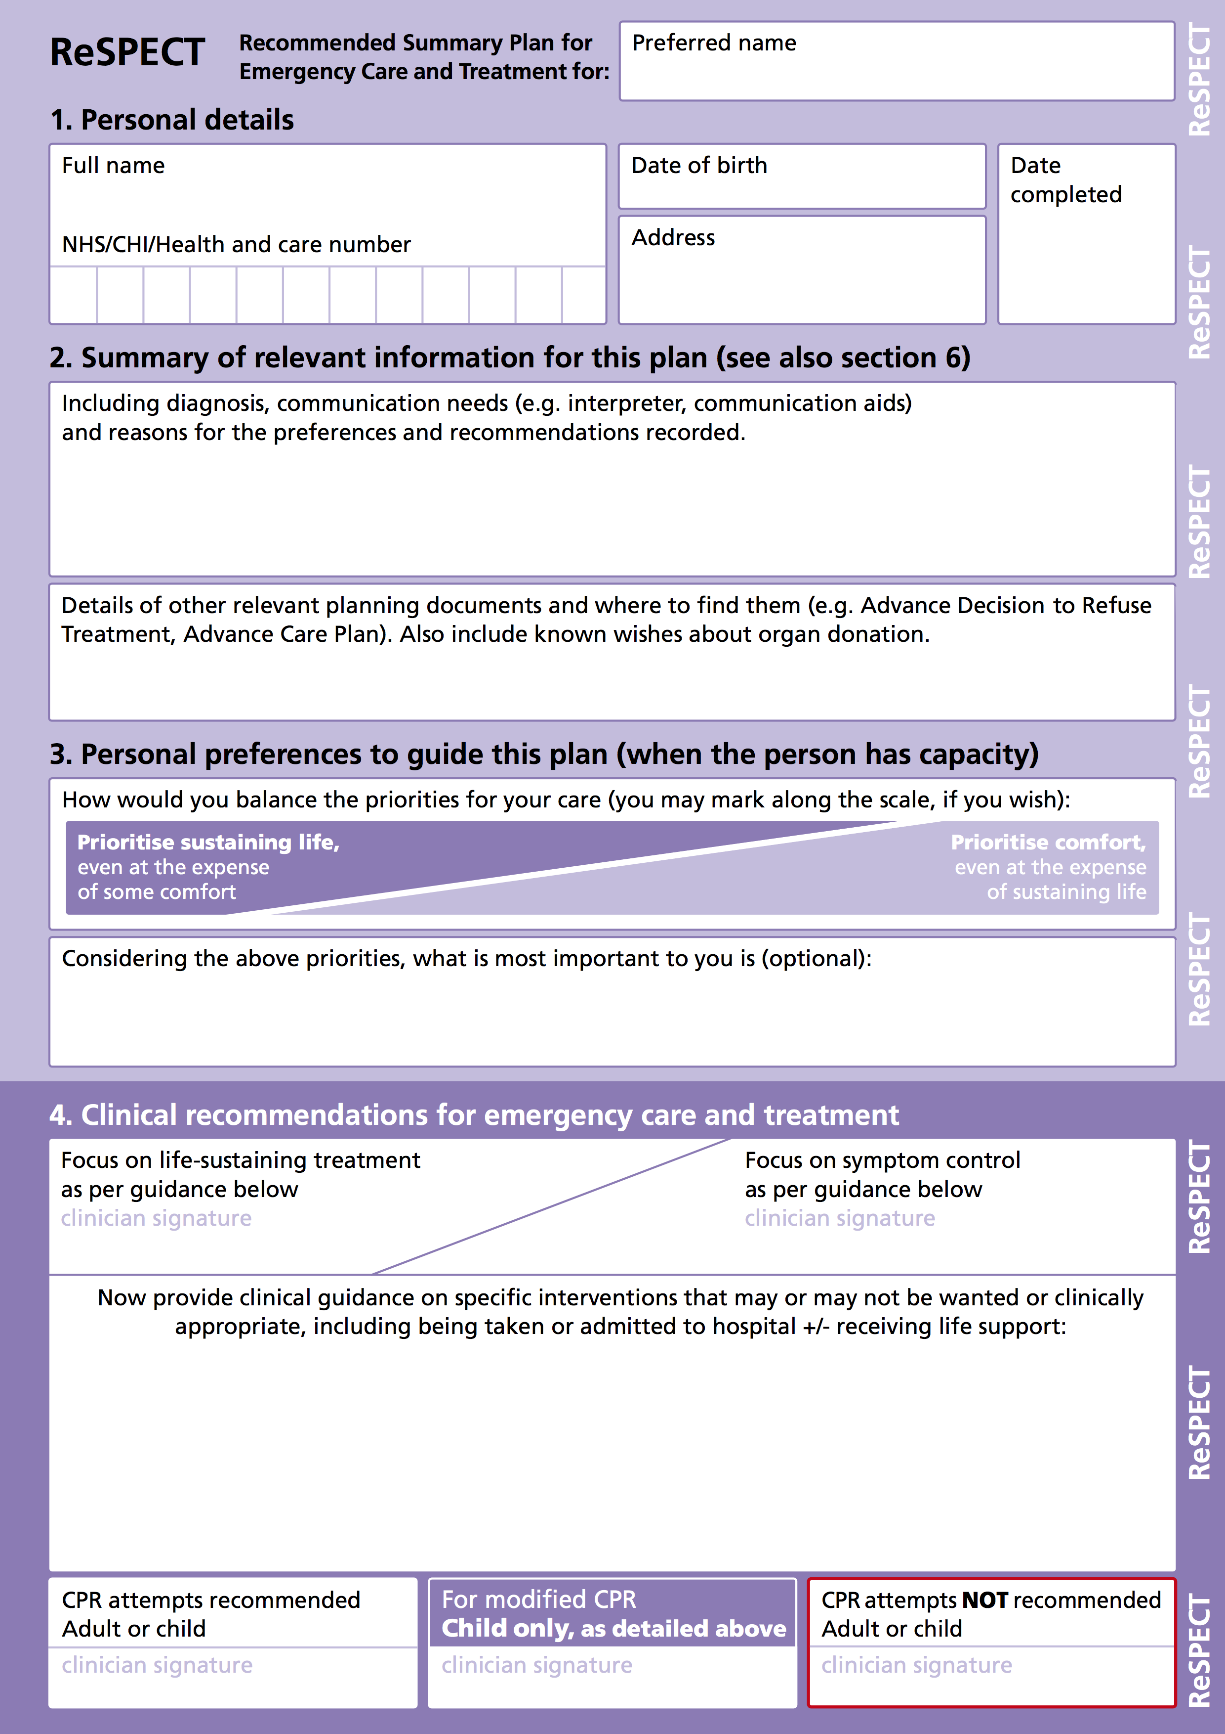
    Completing a ReSPECT form – 2
Discuss with the parent(s) their child’s condition and prognosis and any special needs - summarise these
Ask about and record details of other plans or documents (e.g. CYPACP)
ReSPECT — child or baby

Slide 10
    Completing a ReSPECT form – 3
You may use this scale to help parent(s) understand the balance between priorities of care and identify their priority for their child
Record (if they wish) the aspect(s) of life most important to their child
ReSPECT — child or baby

Slide 11
    Completing a ReSPECT form – 4a
Sign to indicate the agreed main focus of care
List elements of emergency care and treatment that
should be considered
they would not want
would not work in their child’s situation
Include whether or not they would want their child to be taken to hospital and in what circumstances
ReSPECT — child or baby

Slide 12
    Completing a ReSPECT form – 4b
Remember that all recommendations
should be shared decisions
whenever possible
ReSPECT — child or baby

Slide 13
    Completing a ReSPECT form – 4c
Sign a recommendation about CPR
If a ’modified’
resuscitation sequence is agreed
Sign the middle box
Record agreed modifications above
ReSPECT — child or baby

Slide 14
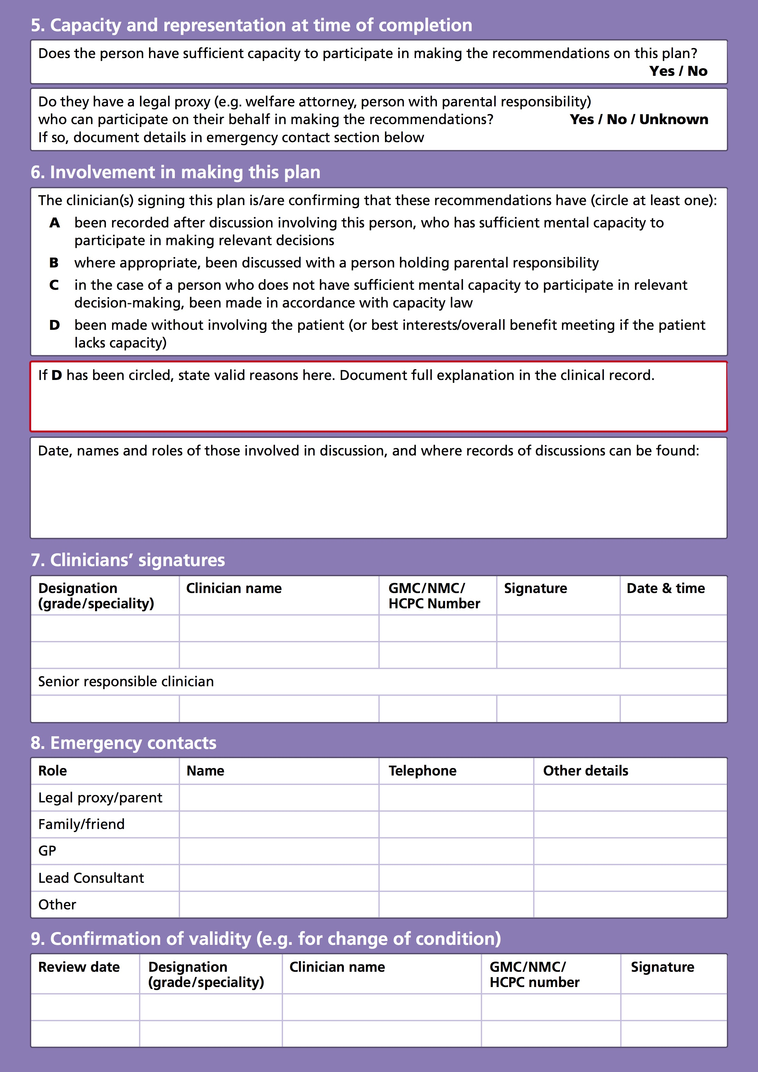
    ReSPECT
Having completed discussion,
shared decision-making and
recording…
… turn over the form to verify
the basis for the agreed
recommendations
ReSPECT — child or baby

Slide 15
    Completing a ReSPECT form – 5
Indicate here whether or not the child is competent
in respect of these decisions
Indicate here whether or not there is a person with parental responsibility
ReSPECT — child or baby

Slide 16
    Completing a ReSPECT form – 6
Circle A to confirm involvement of a competent child and/or B to indicate involvement of a parent
Circle D if there has been no involvement of either
If there has been no involvement of child state valid reasons here
Record dates of discussions and names and roles of those involved, including any court ruling
ReSPECT — child or baby

Slide 17
    Completing a ReSPECT form – 7
Complete this line in full to confirm that you have completed the form accurately
The senior responsible clinician should be aware of and agree to this plan. If you are not that clinician they should be asked to endorse it by completing this line at the earliest practicable opportunity
ReSPECT — child or baby

Slide 18
    Completing a ReSPECT form – 8
List name and contact details of all those who must be contacted
and those that the child and parents would want contacted in an emergency (and are willing to be contacted)
ReSPECT — child or baby

Slide 19
    Completing a ReSPECT form – 9
Leave this box blank at initiation
When a child’s condition changes or they move from one care setting to another (including a change of hospital ward) a senior clinician should review the ReSPECT recommendations, in discussion with the parent(s), and
sign and date here to confirm that they are still valid OR
cancel this form and create a new revised one
ReSPECT — child or baby

Slide 20
    Summary
If appropriate and if time allows, use advance care planning to inform content of the ReSPECT form
Make shared decisions for the current situation
Work through ReSPECT systematically to establish
▫ the background to the recommendations
▫ the parent’s preferences for care and treatment
▫ agreed clinical recommendations
Complete page 2 fully to confirm the validity of the plan
ReSPECT — child or baby

