Slide 1

Frimley ICS Jobs Webinar
10th December 2021

Slide 2
Today’s Agenda
# | Item | Lead(s)
1 | Introduction | Gaurav Puri
2 | Frimley Health NHS Foundation Trust | Daniel Winchcombe, Neil Webb, Nicola Morgan & Emma Mata
3 | Berkshire Healthcare Foundation Trust | Simon Small
4 | Berkshire Care Association | Sue Dorling
5 | Primary Care | Philip Kelley
6 | Apprenticeships | Nicola Morgan
7 | Allied Health Professionals | Will Firth
8 | Close | Gaurav Puri
*Awaiting Presentations

Slide 3

Frimley NHS Foundation Trust

Slide 4
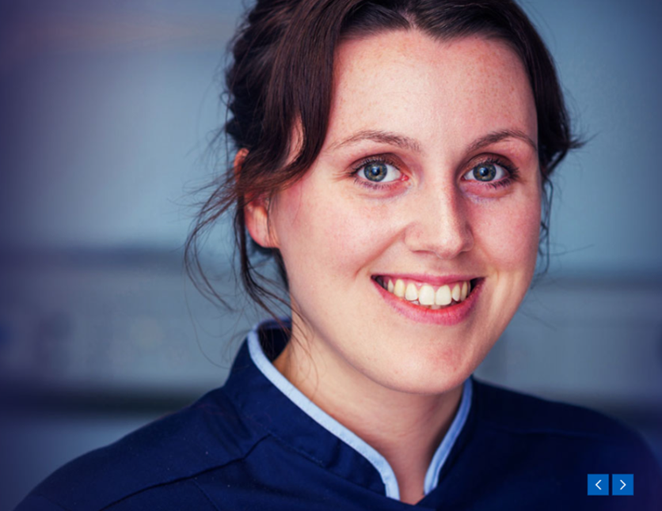
Welcome
Dan Winchcombe - Resourcing Manager
fhft.recruitment@nhs.net
Notes:
Introduce ourselves and our roles

Slide 5

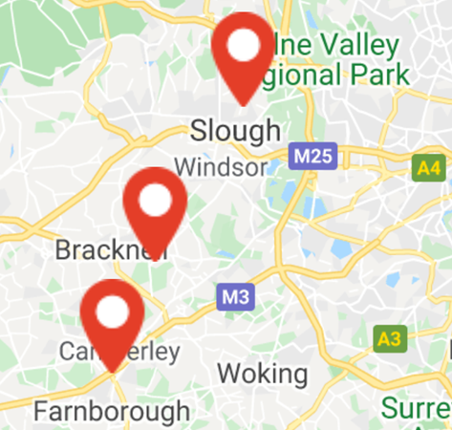
Introduction
A large acute NHS Trust employing around 12,000 people
+ flexible workers
Three main sites:
Frimley Park Hospital, Surrey
Heatherwood Hospital, Ascot, Berkshire
Wexham Park Hospital, Slough
Community services across Berkshire, Hampshire, Surrey
and South Buckinghamshire
Notes:
Introduce ourselves and our roles

Slide 6
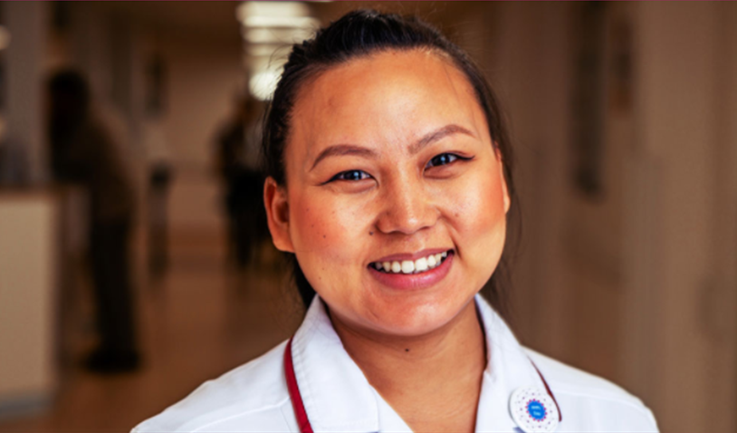
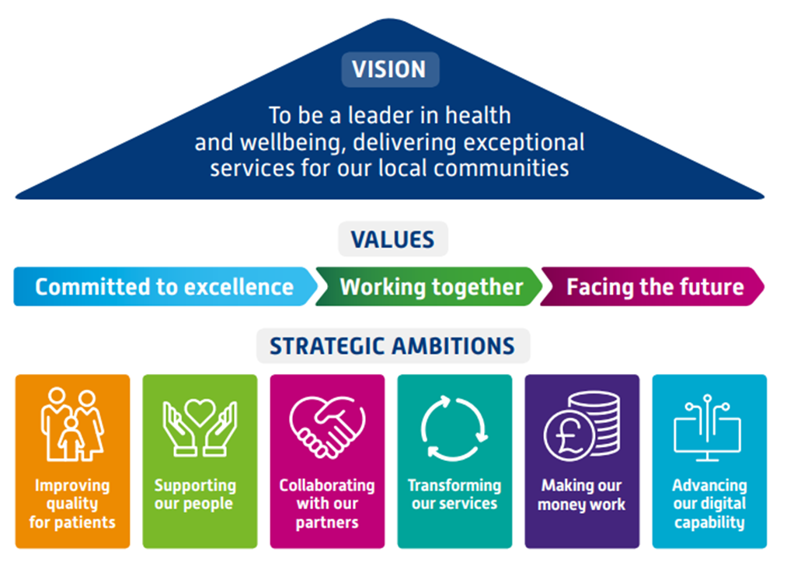
Introduction
Our Strategy 2020-2025
In order to achieve our vision, we have worked with our staff, partners, patients, members and local communities to develop a strategy and plan for 2020 to 2025.
Our Values
Our values guide everything we do now and will do in the future, and set out what is expected from each and every member of the team in the way they treat patients, visitors and colleagues
Notes:
Introduce ourselves and our roles

Slide 7
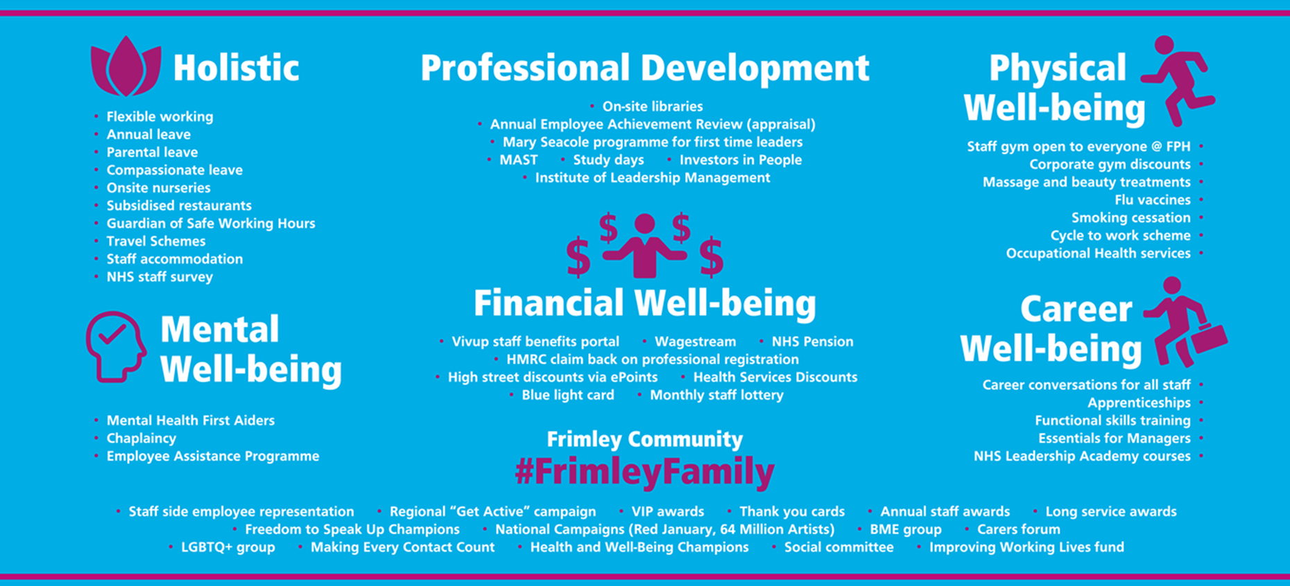


Slide 8
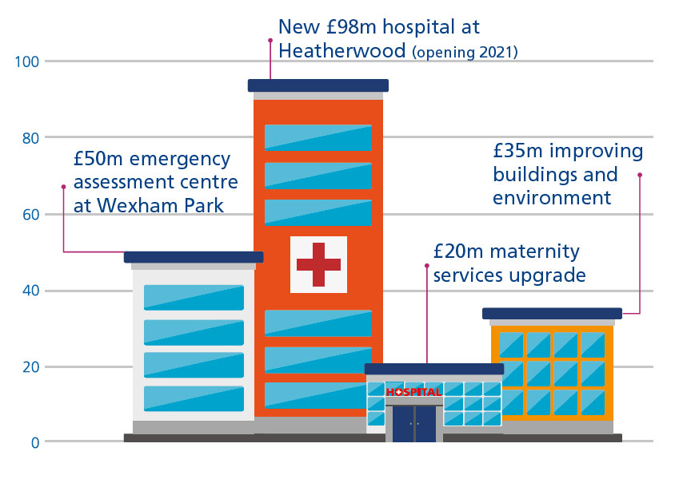
About FHFT?
Notes:
Things we are working on
Improvements to IT and other technology infrastructure, estates- focus on making our hospitals nice places to e
All focused on improving patient experience and staff experience

Slide 9
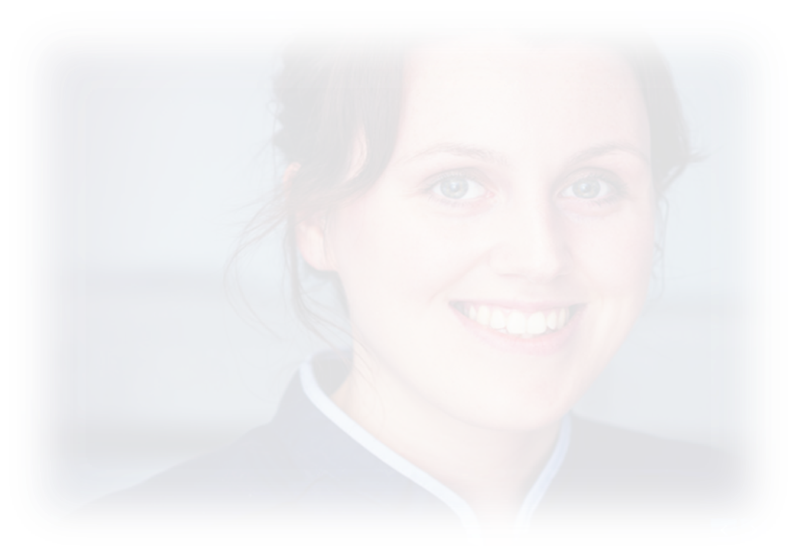



About FHFT?
#FrimleyFamily
Recognition of achievements
Strong focus on staff health and wellbeing
Investors in People silver award
Learning and development:
Annual appraisal, including development plans
Management skills | Clinical skills | Library
Functional skills | IT Skills | Nursing Associate course
Heath and Safety | Mental Health First Aid | Care certificate
Careers clinics | Apprenticeships | NHS Leadership Academy

Slide 10
Current & Anticipated challenges
Record numbers of patients
Strain on the workforce due to COVID, winter pressures, backlog
Lack of skills required in the UK to fulfil positions
Agility to scale up recruitment in line with expansion of services and New Hospital
Long term fatigue of clinicians, leading to retention issues
Market competition both from other Trusts and Private sector
Notes:
Introduce ourselves and our roles

Slide 11
Development opportunities
Nikki Morgan
Learning and Development Manager

Slide 12
Apprenticeships
Functional Skills
Career Progression

Slide 13
Apprenticeships
Real job
Any age
Recognised qualification
Funded by the Trust
Level 2-7

Slide 14
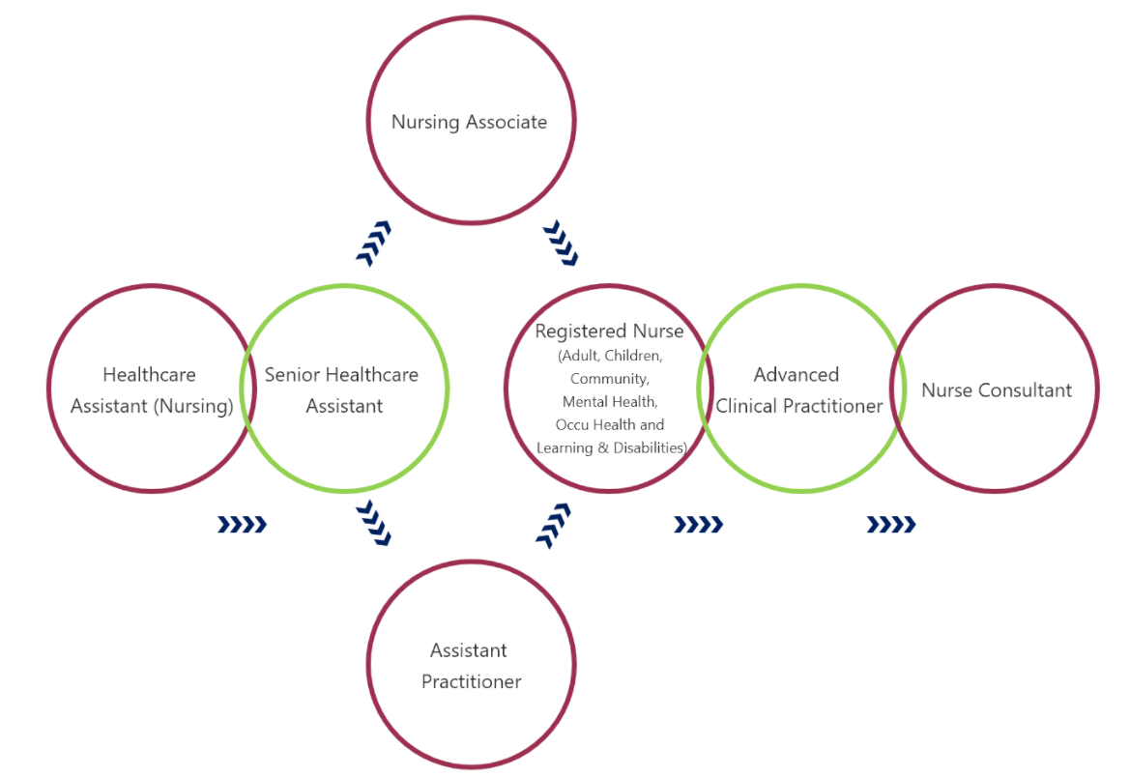
Healthcare Support Worker level 2 Apprenticeship
Offered to all new Band 2 HCA
12 to 15 months
On completion will gain a level 2 – equivalent to GCSE’s

Slide 15
Functional Skills
As a Trust we offer support with your Functional Skills, English and/or Maths
This is funded through the Trust
If you are required to gain your Functional Skills as part of your Apprenticeship, this will be done with a training provider that looks after your Apprenticeship

Slide 16
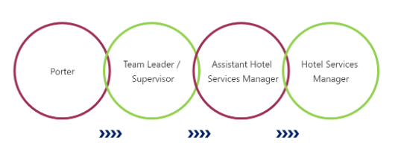
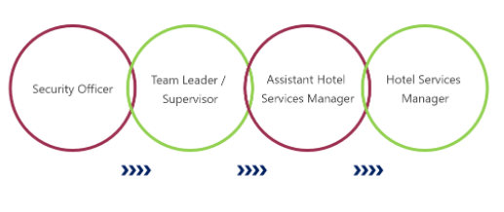
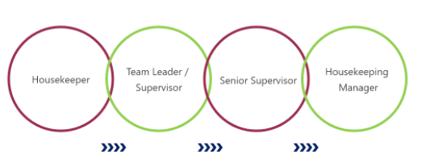
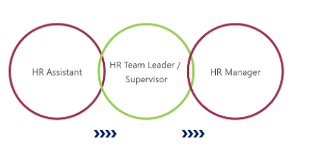
Career progression

Slide 17
Clinical Care Assistant Pathway
Emma Mata
Learning Environment Lead
Notes:
Introduce ourselves and our roles

Slide 18
Clinical Roles
Surgery
Medicine
Accident and Emergency
Community
Critical Care
Orthopaedics

Slide 19
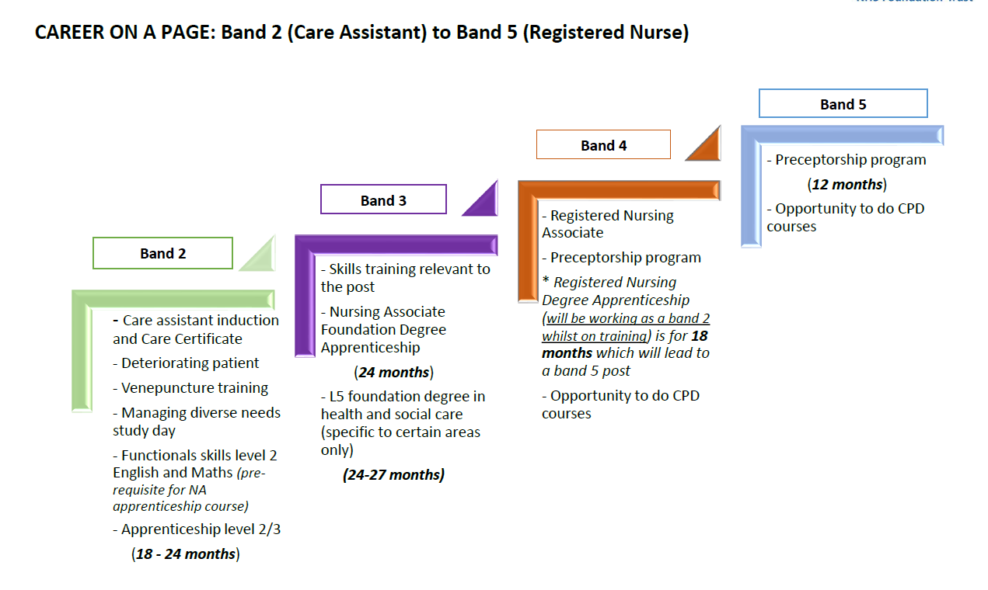

Slide 20
Available opportunities?
Nursing and Midwifery
Bank Care Assistants
Care Assistants – Elderly Care
Care Assistants – Orthopaedics
Health Care Support Workers
Orthopaedic Kit Coordinators
Rehab Support Worker
Administrative Services
Respiratory Team Administrator - Community Service
HR Services Assistant
Clinical Governance Administrator PGMC Receptionist and administrator
Support Services
Bank Porter
Part-time Evening House Keeper
Ward Host Supervisor
Theatre Porter
Orthopaedic Kit Coordinators
Rehab Support Worker
Health Science Services
Medical Laboratory Assistant
Why Not consider working on “The Bank”?
talent pool of people who can work across many work areas and provide cover for maternity leave and temporary vacancies.
Notes:
Introduce ourselves and our roles

Slide 21
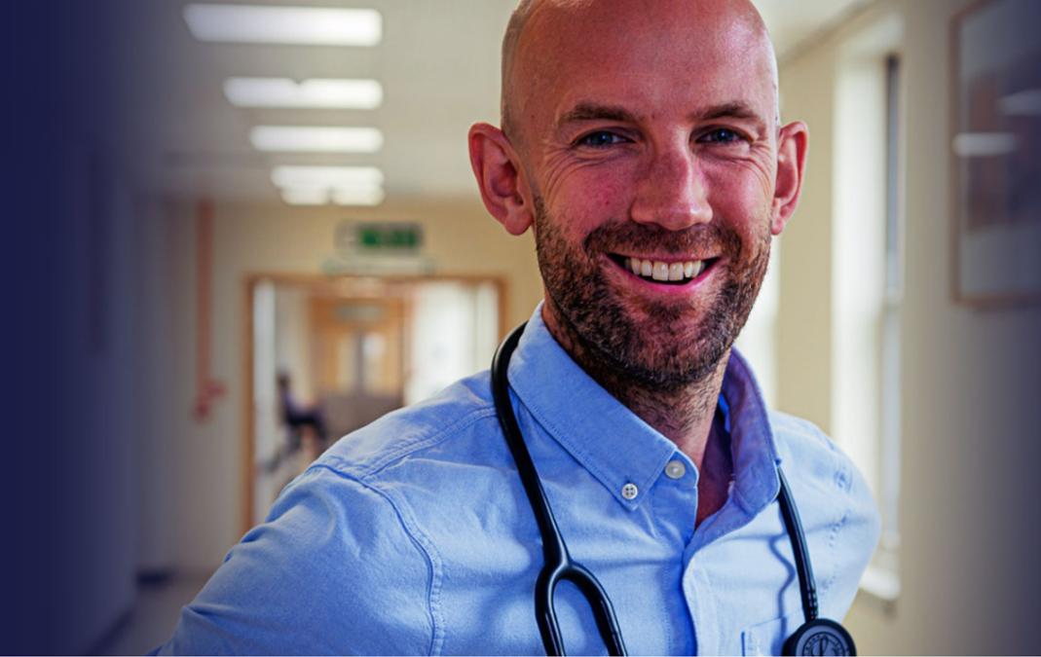

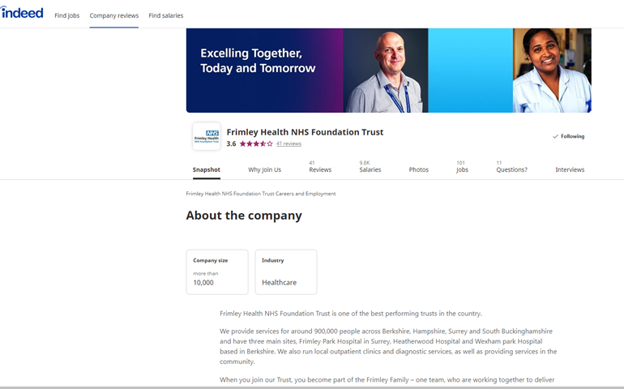
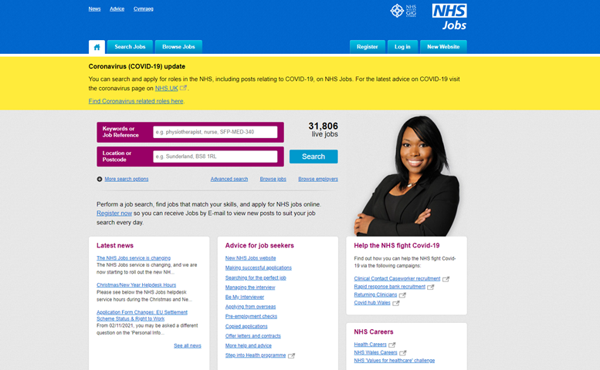
How do I apply?
Access our new careers site
https://careers.fhft.nhs.uk/
Navigate to careers page, click tiles to access
Access via Indeed FHFT page
Access via NHS Job
Notes:
10% of our workforce are support services!

Slide 22
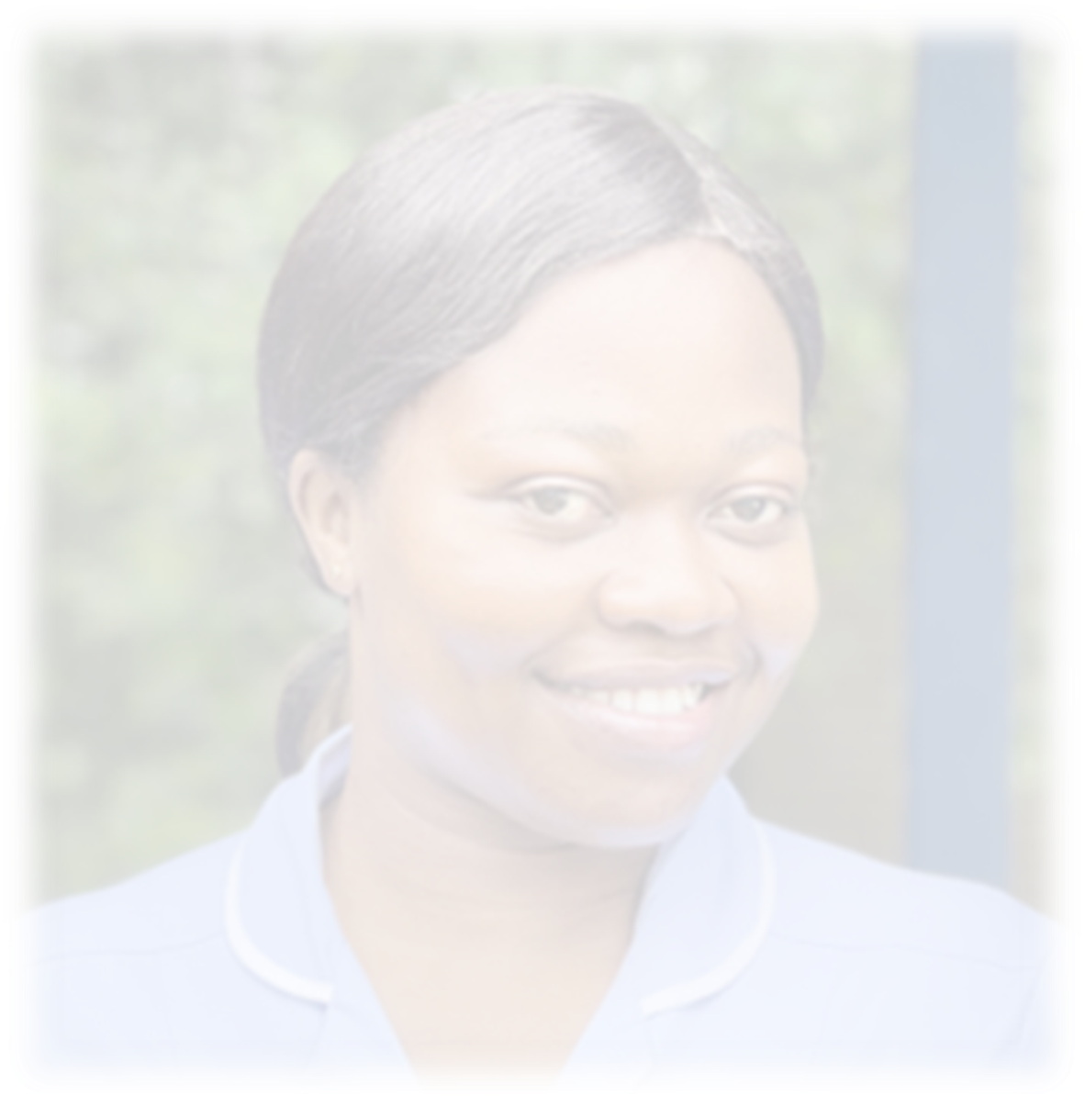
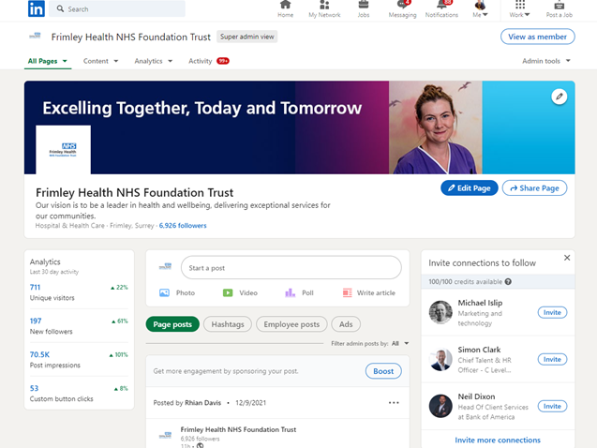

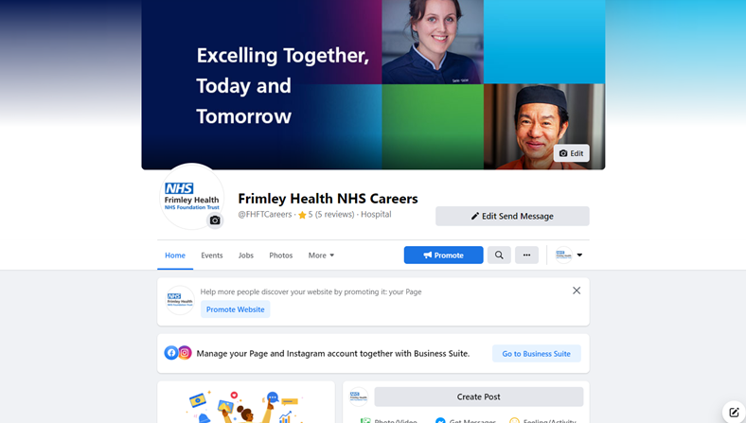
Current Opportunities
Available on various social media
Twitter
Facebook
Instagram
Linked in
Check out our FHFT page on You Tube and watch some useful content about from some of our staff
Notes:
10% of our workforce are support services!

Slide 23




Thank You
Daniel Winchcombe
daniel.winchcombe@nhs.net
Heatherwood

Slide 24
Come and work for
Berkshire Healthcare
Simon Small

Slide 25
Introduction to Berkshire Healthcare
Community and mental health trust providing wide range of services to people of all ages living in Berkshire.
Rated “Outstanding” by the CQC which reflects the level of care and commitment our staff have in providing the best services possible.
“Global Digital Exemplar” which empowers us to transform patient care through new technologies

Slide 26
Berkshire Healthcare’s role
We deliver joined up physical and mental health services, helping people to remain independent at home for as long as possible and providing the care and support that best meets the needs of our patients.
Provide support for our patients both within our inpatient wards or out in the community.
Offer a wide range of services aimed at young people, adults and older people to support and treat mental health, physical health and sexual health conditions.
Work in partnership with Berkshire’s two acute hospital trusts, Royal Berkshire Hospital NHS Foundation Trust and Frimley Health NHS Foundation Trust and work closely with our six local authorities and a diverse range of community and charitable organisations.

Slide 27
Current / Anticipated challenges
Increasing number of available roles particularly for clinical staff across the breadth of Berkshire
Making the best use of funding to support our transformational work and resource our exciting new projects/teams
During this busy winter period, ensuring that we continue with our commitment to our Quality Improvement Programme to improve patient, staff and partner experiences

Slide 28
What kind of opportunities
We have a wide range of opportunities across the trust
Healthcare assistants
Therapy assistants
RGN and RMNs
OTs, Physio's, Podiatrists and Speech & Language roles based within inpatients, in clinics or in the community
Community mental health roles across all professional groups
Opportunities in specialist teams (sexual health, dietetics, rapid community response to name a few)
Plus a range of administrative posts in corporate and clinical services

Slide 29
Pathways to apply
Use NHS Jobs – all of our vacancies for substantive permanent/fixed term roles are advertised here, make sure you set up an account and create alerts for roles that you are interested in. https://www.jobs.nhs.uk/xi/search_vacancy/?action=search&master_id=120886
Contact our Resourcing Team – If you are unable to find a suitable role or are keen for a route into Berkshire Healthcare, please contact the resourcing team. resourcingandretention@berkshire.nhs.uk
Contact our Temporary Staffing Team – If you are interested in bank work we have a wide variety of roles and shifts available depending on experience. If you would like to talk through your options or for any advice please contact the team. temporarystaffingteam@berkshire.nhs.uk

Slide 30
Thank you
questions…

Slide 31


BCA Workforce development
Fidelma Tinneny & Sue Dorling

Slide 32

Introduction to the Organisation
Berkshire Care Association is a not for profit organisation, run by the sector for the sector, representing CQC registered care providers in Berkshire. We are the voice of the care sector.
We work with other care associations locally and nationally with the Care Association Alliance
We are made up of (mostly) volunteers who run and
manage care homes and dom care services in Berkshire. . We do not receive any statutory local or national
funding.
This Photo by Unknown Author is licensed under CC BY

Slide 33
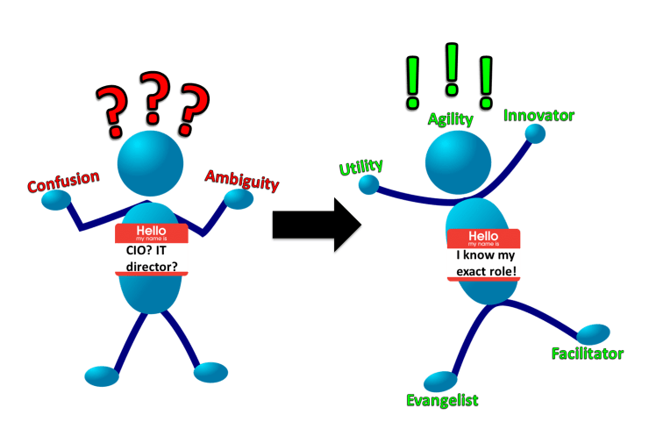
Role of the organisation
To represent providers
To promote standards of care and service
To communicate with managers and care provider services
To signpost, guide and support care providers

Slide 34

current / anticipated challenges
Lack of carers, cleaners, chefs, kitchen porters, nurses, managers – quality and quantity
Burnt out and very tired current workforce
Constant barrage of negativity
Perceived hierarchy of statutory organisations
Years of gross under funding
Non ‘sexy’ image
Lack of equality and camaraderie across system and processes
Public trust
Accessibility of equal opportunities e.g. training
Too many agencies recruiting at huge costs

Slide 35

opportunities people can expect to apply for being a Band 2, 3 and 5
No idea how much bands are – this is NHS language
Each employing organisation – i.e. care home / dom care providerset their own rate
Hourly rates vary from minimum wage to £10.50+ per hour depending on times worked (eg evenings and weekends), experience and organisation
Nursing associate salary for full time (40 hours) is approx. £30-32k
Varying opportunities for development and growth depending on interest, input, willingness and responsibilities undertaken
A lot of social mobility and opportunities if circumstances (as described earlier) are in order

Slide 36

pathway to apply
Outside of the NHS and starting from scratch
Currently apply to each individual employing organisation
DBS, references one of which must be from previous employer
Must be vaccinated
On the Vaccination workforce bank
Currently not applicable

Slide 37

How to apply, and a set of links to the relevant areas
There are numerous care operators in each locality
Many advertise on Indeed and in many many other places
Agencies tend to contact applicants making processing much more difficult and expensive for organisations
Generally flexible opportunities for interview
Sue Dorling: sue.dorling@berkscare.co.uk
www.berkscare.co.uk
Tel 01344 893469
Fidelma.Tinneny@arhltd.com
Thank you!

Slide 38

Primary Care
Friday 10 December 2021
Philip Kelley
Director of Improvement and
Workforce (Primary Care) Development

Slide 39
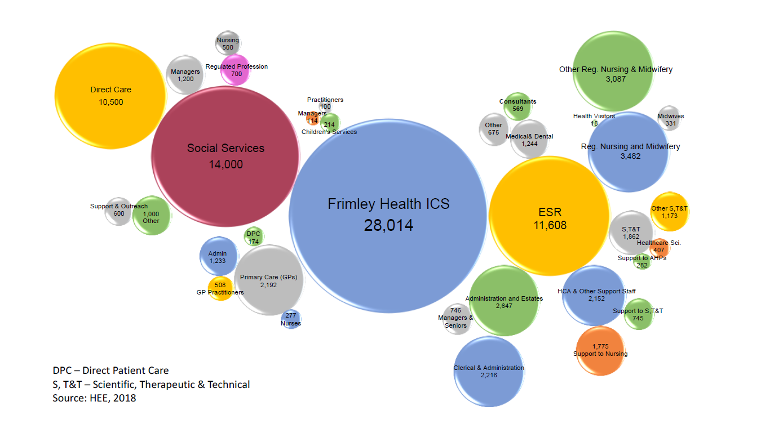

Slide 40
7.8% of the system workforce
Around 9% of the NHS budget
90% of patient contact with the NHS
Source: RCGP, BMA & others
(300m of 330m patient contacts)

Slide 41
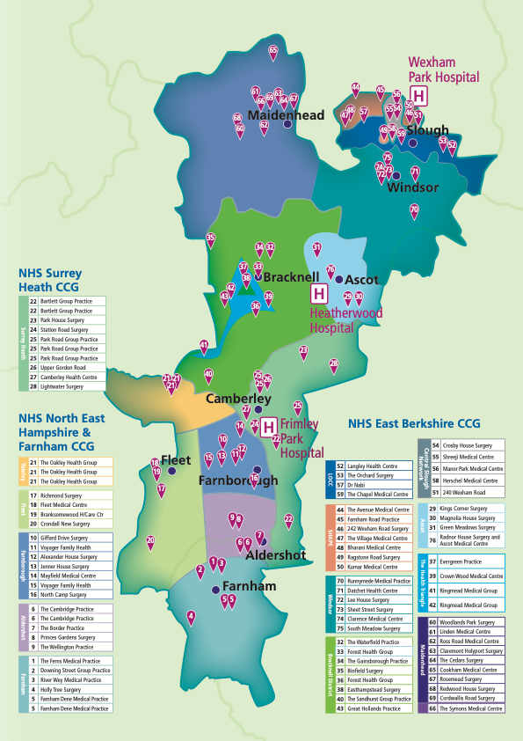
16 Primary Care Networks
covering 72 Practice Partnerships
Slough | Royal Borough of Windsor & Maidenhead | Bracknell Forest | North East Hampshire & Farnham | Surrey Heath
SHAPE | Windsor | Bracknell | Aldershot | Surrey Heath
SPINE | Ascot | Health Triangle | Farnborough
LOCC | Maidenhead | Braccan | Farnham
CSN |  |  | Fleet
 |  |  | Yateley
170,000 | 185,000 | 120,000 | 230,000 | 100,000

Slide 42

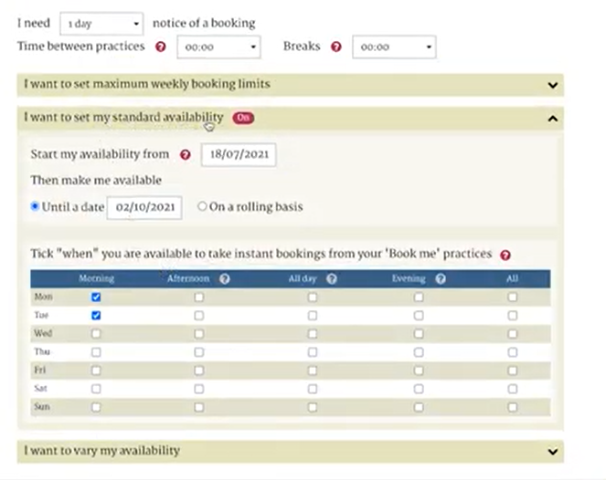
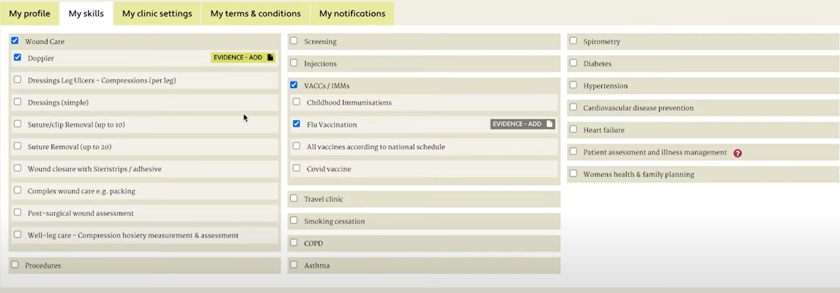
Clinical Roles – LocumDeck4Nurses
Sign up here:
https://www.nasgp.org.uk/ld4n-frimley/
Contact: frimley.traininghub@nhs.net

Slide 43
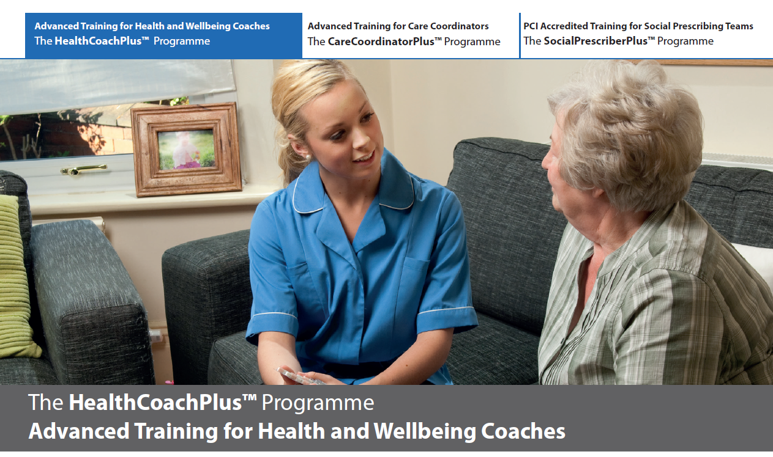



Non-Clinical Roles
Personalisation and Anticipatory Care Teams
Health & Wellbeing Coaches
Social Prescribing Link Workers
Care Coordinators
Primary Care Hubs
Admin
Reception
Care Navigators
Contact: frimley.traininghub@nhs.net

Slide 44
Thank you

Slide 45

Apprenticeships
Nikki Morgan

Slide 46
Apprenticeships
Real job with work based learning
All ages
Recognised qualification
Level 2-7 (Intermediate – Masters)
Duration – min 1 year
Functional Skills
Career development

Slide 47
Healthcare Support Worker level 2 Apprenticeship
12 to 15 months
Funded through the organisation
Level 2 – equivalent to GCSE’s
Need to achieve Level 1 in English
& Maths

Slide 48
Senior Healthcare Support Worker level 3 Apprenticeship
12 - 18 months
Funded through the organisation
Level 3 – equivalent to A 'levels
Need to achieve level 2 in English
& Maths
Choose a pathway - Maternity, AHP,
Theatres, Adult and Children’s Nursing

Slide 49
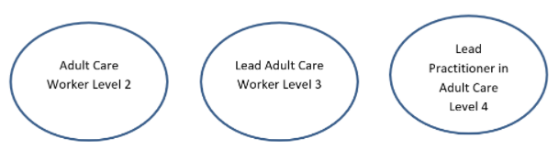
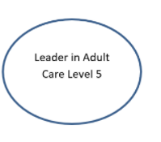
Adult Care Worker Level 2 Apprenticeship
12 - 15 months
Funded through the organisation
Level 2 – equivalent to GCSE’s
Need to achieve Level 1 in English
& Maths

Slide 50
Wider Healthcare – Portering, Security & Housekeeping
Facilities Operative Level 2
12 to 15 months
Funded through the organisation
Level 2 – equivalent to GCSE’s
Need to achieve Level 1 in English
& Maths

Slide 51
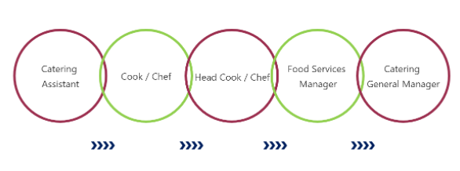
Wider Healthcare – Catering
Production Chef Level 2
12 to 15 months
Funded through the organisation
Level 2 – equivalent to GCSE’s
Need to achieve Level 1 in English
& Maths

Slide 52
Future career development
Depending on your route
and speciality there are a
variety of options:
Nursing Associate level 5
Assistant Practitioner level 5

Slide 53
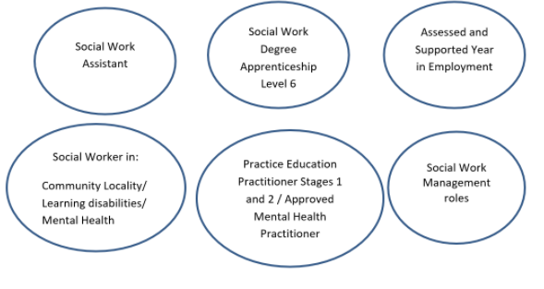
Future career development
Social Worker Degree Level 6 Apprenticeship

Slide 54


FRIMLEY ICS ALLIED HEALTH PROFESSIONALS (AHP) 10th December 2021 Will Firth Frimley ICS AHP Faculty Lead
@FrimleyICSAHPs
Notes:
Hello, Thank you all for joining todays webinar to give me the platform to tell you more about AHPs in Frimley ICS.
My name is Will Firth and I am the AHP Faculty Lead for Frimley ICS. In this role I am bringing together health and social care and education providers together in order to support the supply, education and training activities of AHPs
I am a physiotherapist by background and still work clinically as an advanced practice physiotherapist at Frimley.

Slide 55
The Allied Health Professions
Art therapists
Diagnostic
radiographers
Dietitians
Drama- therapists
Music
therapists
Occupational
therapists
Operating
department
practitioners
Orthoptists
Osteopaths
Paramedics
Physiotherapist
Podiatrists
Prosthetists
and orthotists
Speech and
language
therapists
Therapeutic
radiographers
Notes:
NHS Context: The NHS is the UK’s biggest employer with 1.3m people working for the NHS in its wide range of settings; including hospitals, clinics, surgeries, in the community and in people’s homes.
NHS roles: There are 350 different roles in the NHS. The majority of these are clinical roles where you diagnose and treat patients on a daily basis.
The 15 professions which I’m going to talk to you about are the Allied Health Professions or AHPs for short. This job family comprises the biggest collection of clinical practitioners in the NHS after doctors, nurses and midwives. There are around 117,000 people who have AHP careers in the UK. But we need more!
You will no doubt have heard of a paramedic and a physiotherapist but some of the roles are a little different to work out based on the names, which sometimes don’t give you a clear clue – so they have a bit of an identity crisis with the wider public! Unfortunately I do not have have time to discuss all today, but if you seach ahp on google you will find loads more details on each profression.

Slide 56

What do Allied Health Professionals do?
They provide treatment and help rehabilitate adults and children who are ill, have disabilities, injuries or special needs to live life as fully as possible.
They often manage their own caseload of patients.
Notes:
So what do all AHPs have in common? They all make sure people can live their lives to the fullest:
By diagnosing and treating problems
By reducing pain
By helping manage long-term health problems
By making sure people can still have fun with friends, take care of themselves and do activities which make them happy
Allied health professionals work in teams with other healthcare professionals including doctors, nurses and other allied health professionals.
AHPs often manage their own caseload of patients. It’s not just providing a session of treatment but they may make the initial diagnosis, go on to treat the patient and do follow ups as well.

Slide 57
Becoming an Allied Health Professional
Undergraduate
Degree
Degree Apprenticeship
Postgraduate Degree
Not all AHPs have an apprenticeship | Main route for AHPs | Could study an accelerated degree
Notes:
The allied health professions are a family of specialist roles who use their knowledge and skills to help patients live the fullest lives possible. They work directly with patients, so they can see the difference they make every day.
Studying to become an allied health professional is very hands-on. You’ll help real patients as you earn your qualification, and graduate ready to start a fulfilling career.
You don’t have to study Medicine to be an allied health professional. There are many courses you can do!
It’s not just three years of lectures and textbooks. You’ll go on placements to actual hospitals and practise treating real patients. You’ll make a real difference to people before you even graduate.
You’ll be ready to work as soon as you qualify.

Slide 58

AHPs Working in Frimley ICS (whole time equivalent)
Art Therapist 0.6
Dietitian 43.4
OT 141.8
Orthoptist 7.6
Operating Department Practitioner
Physio 217.4
Prosthetist 1
Diagnostic Radiographer 135.7
SLT 50.3
Podiatrist 17.7
Paramedic 121
ODP 75.2
811.7 wte AHPs
Notes:
We are building an asset map of AHPS working across the system, this is not yet complete, but is an ongoing piece of work. Are next focus will be to review numbers of support workers across the system and there is work directed by Health Education England currently looking at this.
AHPs work across specialities, all ages and jobs can range from band 2 support worker roles to band 9 consultant level roles.

Slide 59











Organisations within Frimley ICS
Notes:
This will give you an idea of the organisations where AHPs work within our system, which include health and social care provides, the private sector, ambulance trusts and charities.
Our aim is to work collaboratively with all organisations across health and social care and engage all AHPs in the work we are doing & together find collaborative solutions to our shared challenges.

Slide 60
Workforce Roadmap
DEVELOP
SUPPLY
Student experience
Preceptorship
Clinical & Professional Development
New roles
New ways of working
RETAIN
Notes:
Our ambition for AHPs including the support worker roles is to create a roadmap to support our AHP workforce from training, to bridging the gap between education/training and employment, to enable all AHPs to achieve their potential in their roles, work to the top of their scope of practice and have the ability and confidence to move into new roles and opportunities,
Myself for example band 5 physio at WPH and HWD – moved around the ICS gaining other experiences , before recently returning to work within the Frimley ICS to work in the leadership role I am doing now and also do hours at FPH working as an advanced practice physiotherapist.
I think that is the really attractive draw to working as an AHP within Frimley ICS – that there are lots of opportunities for development and variation in your work. I have never found my job boring – maybe stressful at times and tiring , but never boring!

Slide 61
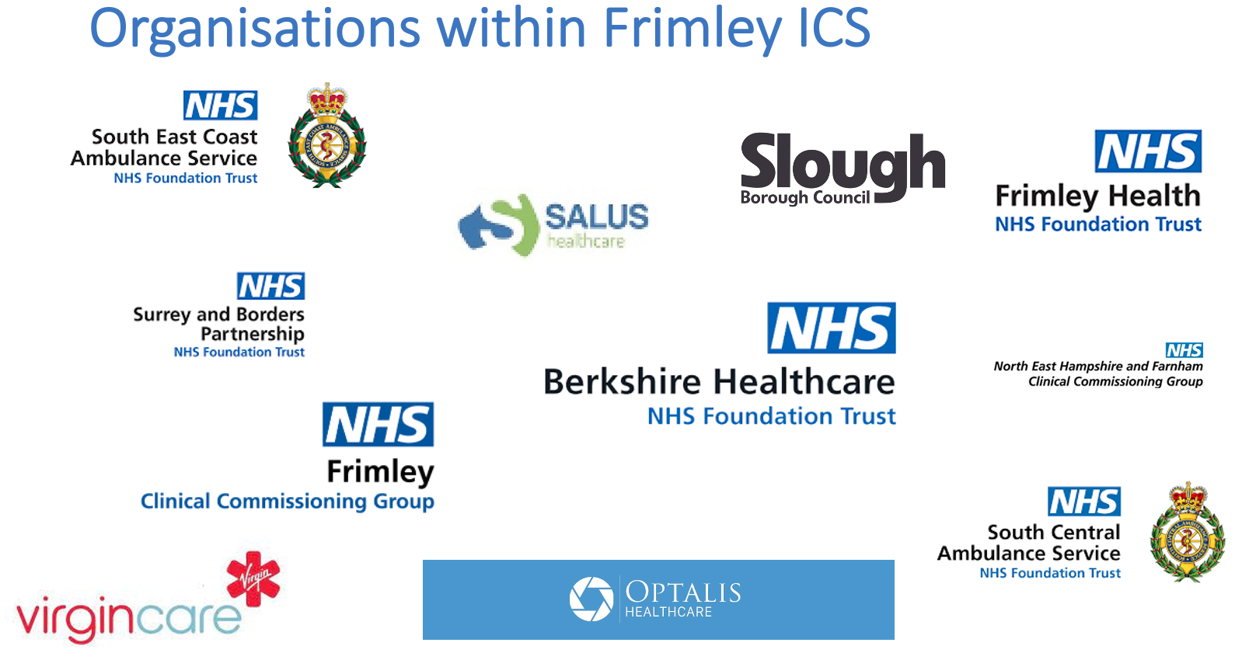
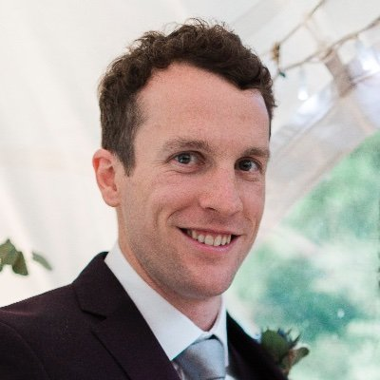
Work Opportunities
Return to practice
International return to practice
Support worker roles
Apprenticeships
Work Experience (Spring Pod)
NHS jobs, Frimley ICS website, Local Authority Websites….
Will Firth
AHP Faculty Lead
Email: w.firth@nhs.net
Twitter: @WilFirth

Slide 62
Close

