Slide 1

Who’s in Charge? Social Media Assets
#WhosInCharge? #SafeSleep
#ThinkPlanShare

Slide 2
Who’s in charge? Safe sleep campaign
NHS Frimley and Frimley Healthier Together are championing resources to prompt parents and carers to think, plan and share “Who’s in Charge?”
This is in response to sadly several baby and infant deaths where alcohol had been consumed by the responsible adult and is considered to be a contributing factor.
This campaign is designed to be used widely during w/c15th – 21st August 2022. Materials can continue to be used post campaign, and will serve as a good reminder to parents and carers, about who’s in charge when alcohol is being consumed whilst caring for babies and children.
A press release will be issued on our website on the morning of 15th August 2022. This is embargoed until this date. Find it here - News | Frimley Health and Care

Slide 3
Campaign assets / link to download
The following slides contain the assets for the Who’s in charge? - Safe sleep awareness campaign
Assets are provided in a size for Facebook and Instagram. They can be downloaded from here
Short links are provided for the campaign posts. Note there is a landing page link plus links to the two different videos. The link is not the same for all posts
Hashtags for the campaign:
#WhosInCharge?
#SafeSleep
#ThinkPlanShare
Landing page for the campaign: https://bit.ly/3cYdwn6
It is anticipated that this campaign will run from 15th – 21st August 2022.

Slide 4
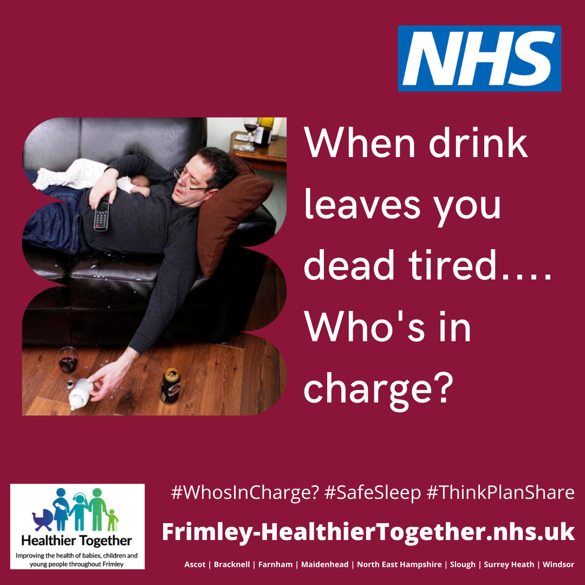
Message one for use on Facebook, Twitter & Instagram
When drink leaves you dead tired…. Who’s in charge?
Drinking and sleeping with your child can have fatal consequences.
If you are drinking alcohol at home, stay in control.
#WhosInCharge? #SafeSleep #ThinkPlanShare
https://bit.ly/3cYdwn6

Slide 5
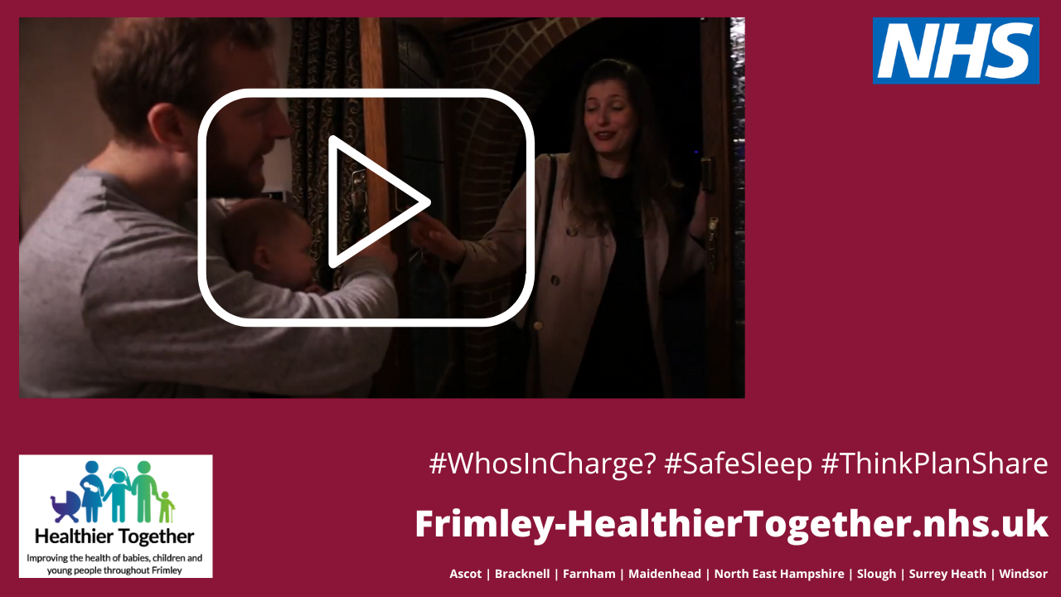
Message two for use on Facebook, Twitter & Instagram
Heading out for a drink, tonight? Think, Who’s in charge?
You would never endanger your baby’s life on purpose, but you could be putting their safety at risk if you drink while looking after them.
#WhosInCharge? #SafeSleep #ThinkPlanShare
https://bit.ly/3vSmwAT

Slide 6
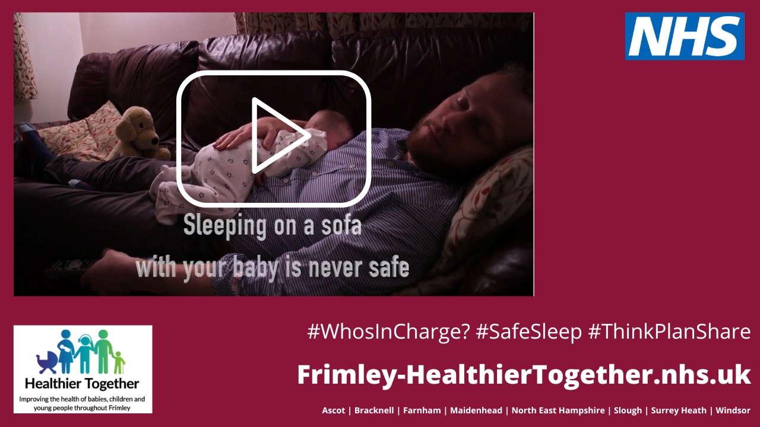
Message three for use on Facebook, Twitter & Instagram
We are working to raise awareness of the risks of drinking alcohol whilst caring for young babies and children.
If you are planning on drinking, remember to think, plan and share with others, who’s in charge.
#WhosInCharge? #SafeSleep #ThinkPlanShare
https://bit.ly/3BwLZDx

Slide 7
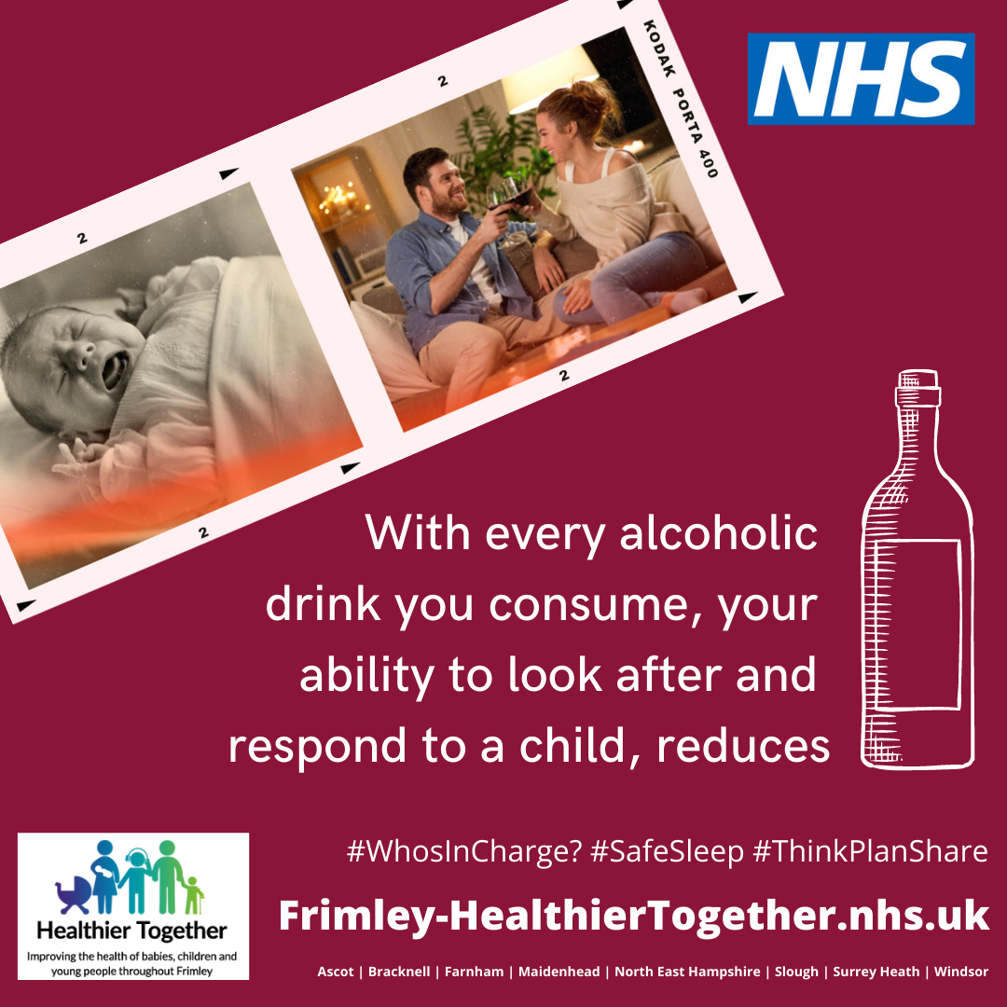
Message four for use on Facebook & Instagram
With every alcoholic drink you consume, your ability to safely look after and respond to a child reduces.
Before you drink, at home, when out, or when on holiday, ask yourself who’s in charge?
Have a plan. Communicate the plan. Keep everyone safe.
#WhosInCharge? #SafeSleep #ThinkPlanShare
https://bit.ly/3cYdwn6

Slide 8
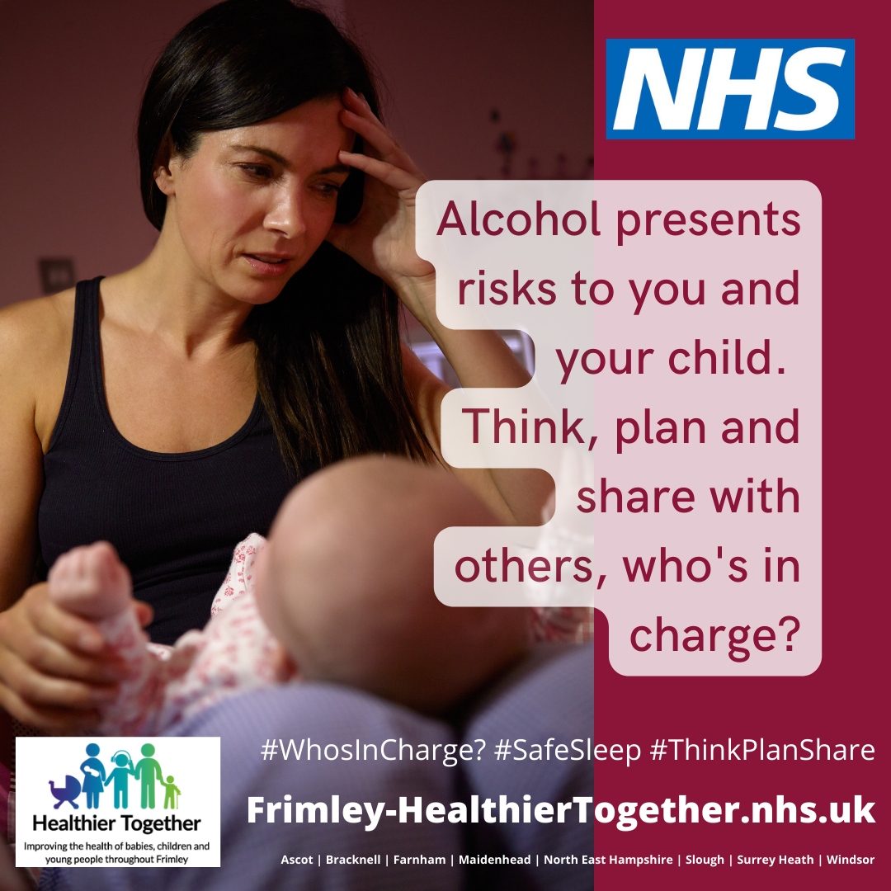
Message five for use on Facebook, Twitter & Instagram
Having a few drinks with friends and family in the evening summer sunshine?
Alcohol presents risks to you and your child. Think, plan and share with others, who’s in charge?
#WhosInCharge? #SafeSleep #ThinkPlanShare
https://bit.ly/3cYdwn6

Slide 9
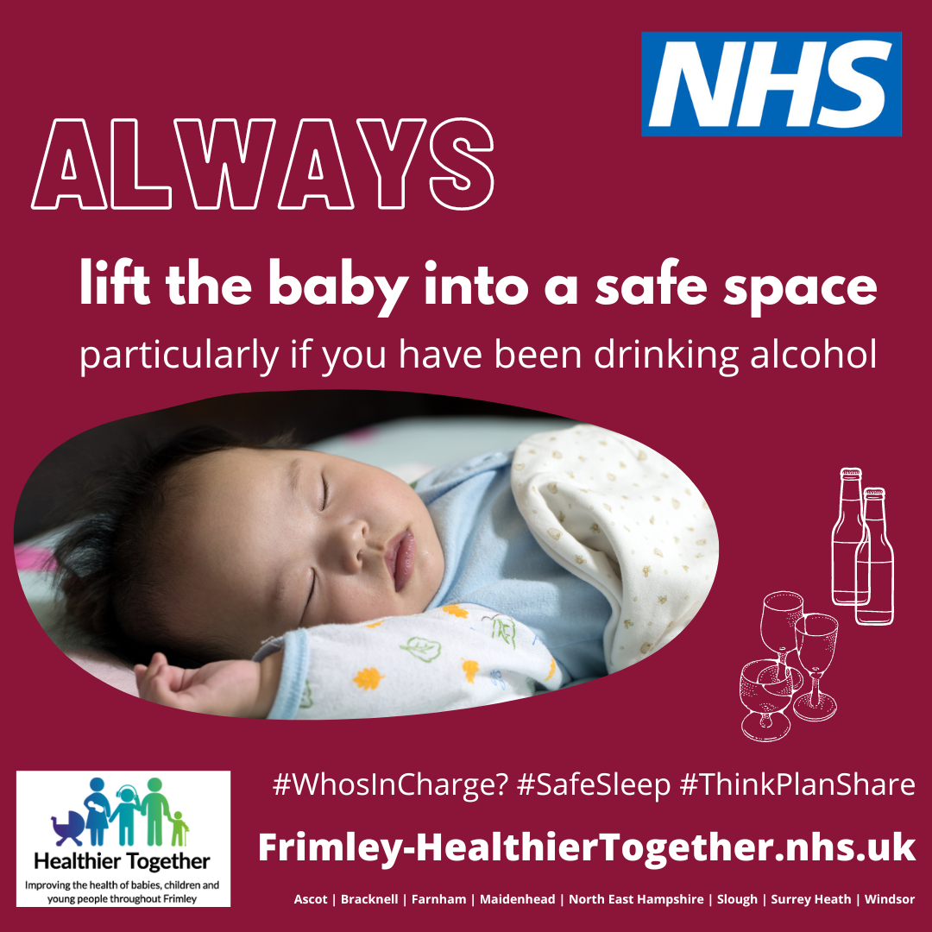
Message six for use on Facebook, Twitter & Instagram
Sleeping on a sofa with a baby can increase the risk of infant death by 50 times according to @LullabyTrust
Always lift the baby into a safe space, particularly if you have been drinking alcohol.
#WhosInCharge? #SafeSleep #ThinkPlanShare
https://bit.ly/3cYdwn6

Slide 10
Message seven for use on Facebook, Twitter & Instagram
Heading off to the pub later for a few drinks before going home to the family?
If you’ve got a baby or young child to care for, stay in control.
Alcohol reduces your ability to respond to their needs.
#WhosInCharge? #SafeSleep #ThinkPlanShare
https://bit.ly/3vSmwAT

Slide 11
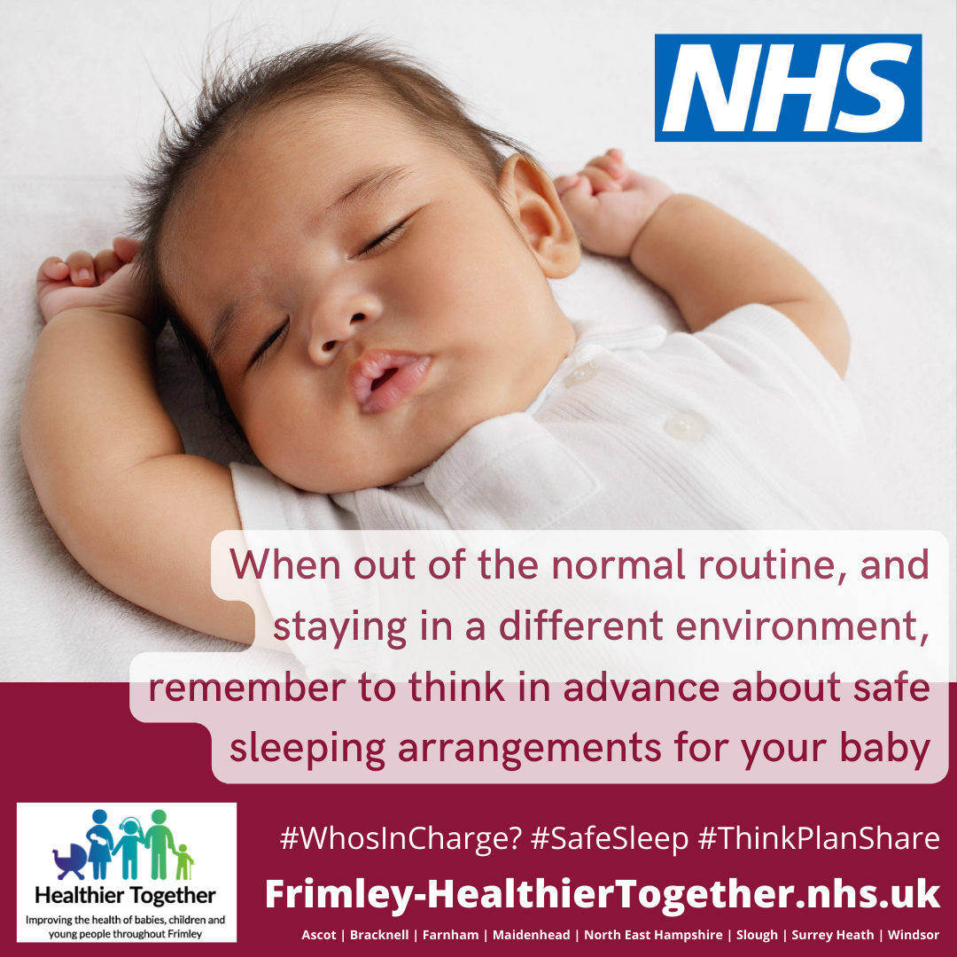
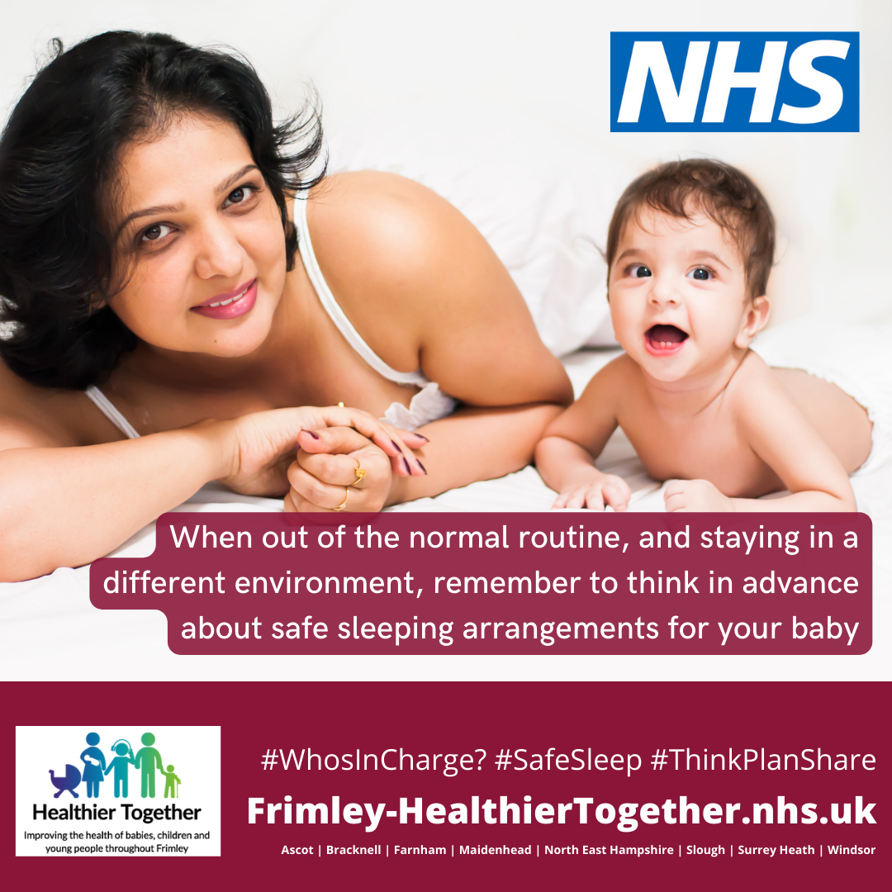
Message eight for use on Facebook & Instagram
Going on holiday with your baby this summer? Relaxing with a few drinks whilst watching the sunset from the balcony or bar?
When out of the normal routine, and staying in a different environment, remember to think in advance about safe sleeping arrangements for your baby.
#WhosInCharge? #SafeSleep #ThinkPlanShare
https://bit.ly/3cYdwn6

Slide 12
Message eight for use on Twitter
Going on holiday with your baby this summer?
When out of the normal routine, and staying in a different environment, remember to think in advance about safe sleeping arrangements for your baby.
#WhosInCharge? #SafeSleep #ThinkPlanShare
https://bit.ly/3cYdwn6

Slide 13
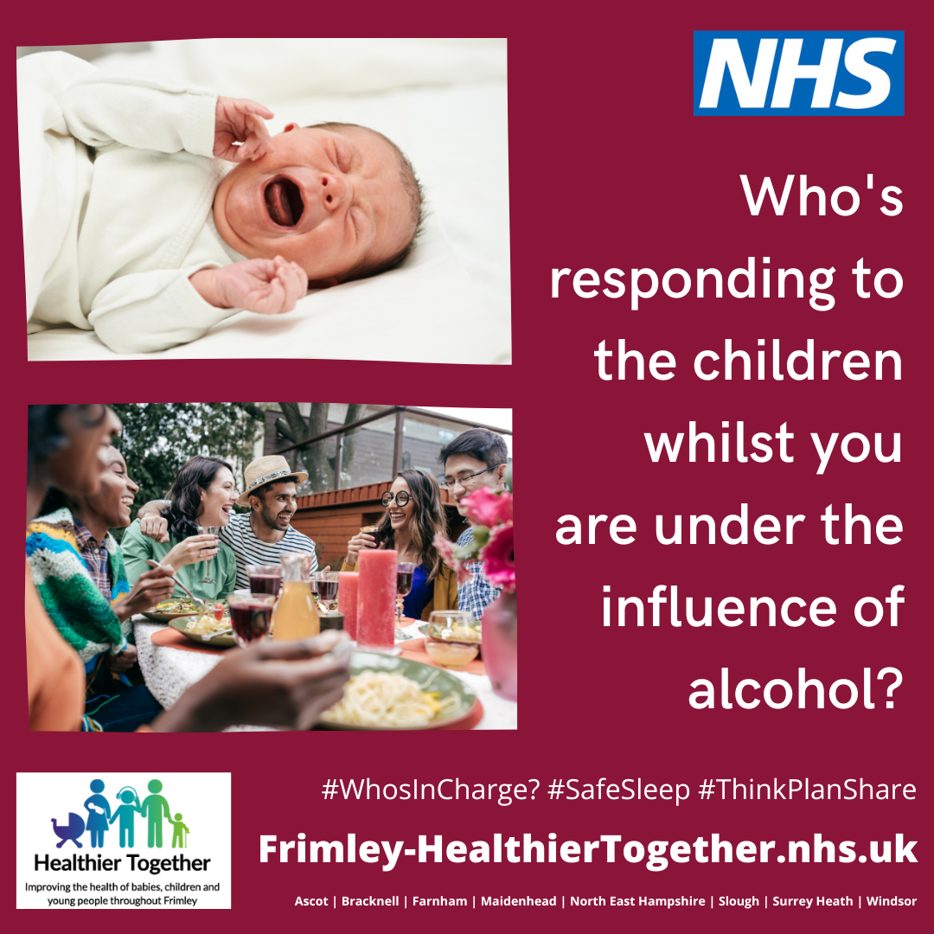
Message nine for use on Facebook & Instagram
You finally made it to your holiday home, unpacked and sat down for the evening. Maybe you are unwinding over a glass of wine, or a beer?
Remember to think about who’s in charge of responding to the children whilst you are under the influence of alcohol and in a new environment.
#WhosInCharge? #SafeSleep #ThinkPlanShare
https://bit.ly/3cYdwn6

Slide 14
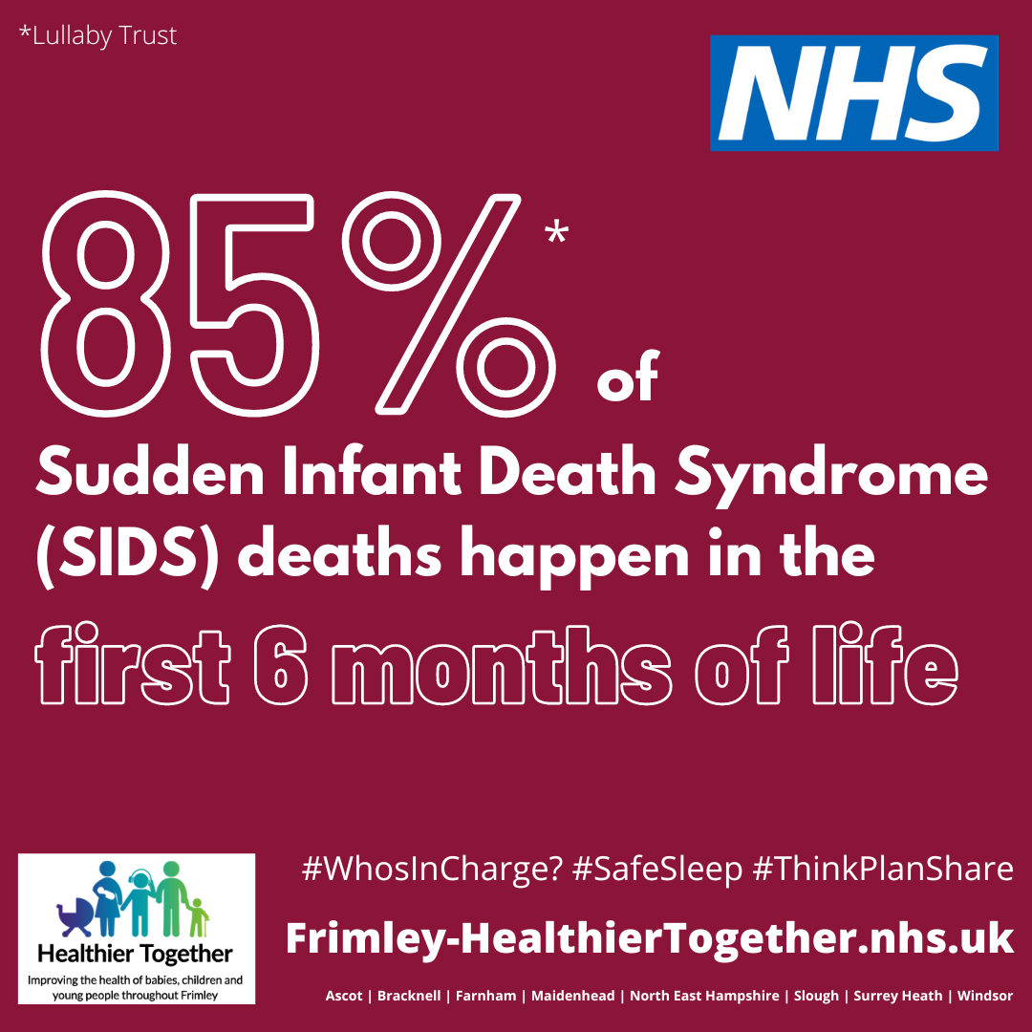
Message ten for use on Facebook & Instagram
86% of Sudden Infant Death Syndrome (SIDS) deaths happen in the first 6 months of life.
Most of these tragic incidents involved parents co-sleeping in unsafe sleep environments with infants, often when the parents had consumed alcohol.
Always think, plan and share, who’s in charge of your child when alcohol is being consumed.
#WhosInCharge? #SafeSleep #ThinkPlanShare
https://bit.ly/3cYdwn6

Slide 15
Message ten for use on Twitter
Most tragic SIDS involve unsafe co-sleeping environments with infants, often when parents had consumed alcohol.
Always think, plan and share, who’s in charge of your child when alcohol is being consumed.
#WhosInCharge? #SafeSleep #ThinkPlanShare
https://bit.ly/3cYdwn6

Slide 16
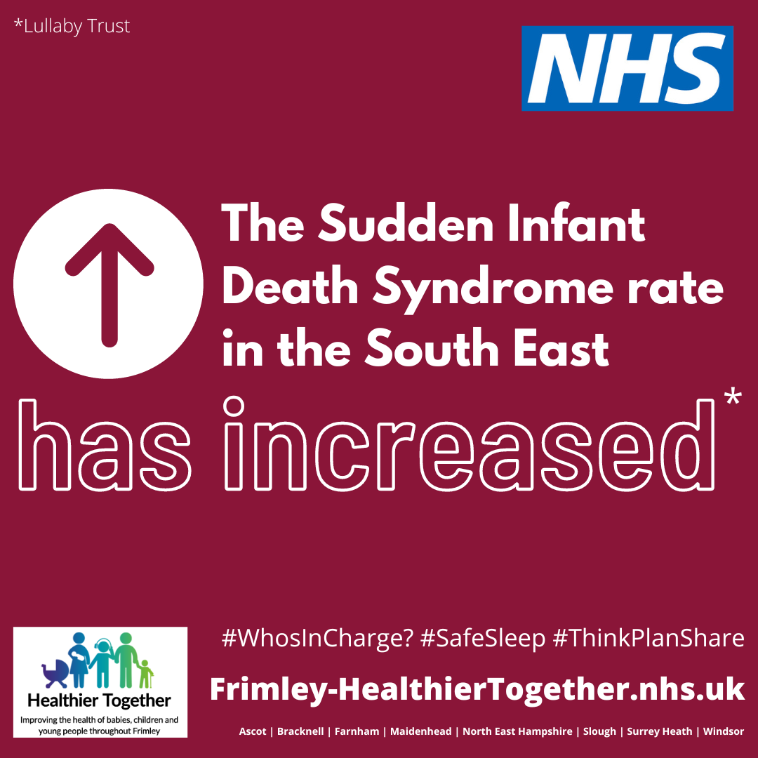
Message eleven for use on Facebook & Instagram
The Sudden Infant Death Syndrome rate in the South East has increased since 2018 and is now above average for England and Wales.
Think, plan and share your sleep arrangements with all those who are involved in the care of your baby, particularly when alcohol is being consumed.
#WhosInCharge? #SafeSleep #ThinkPlanShare
https://bit.ly/3cYdwn6

Slide 17
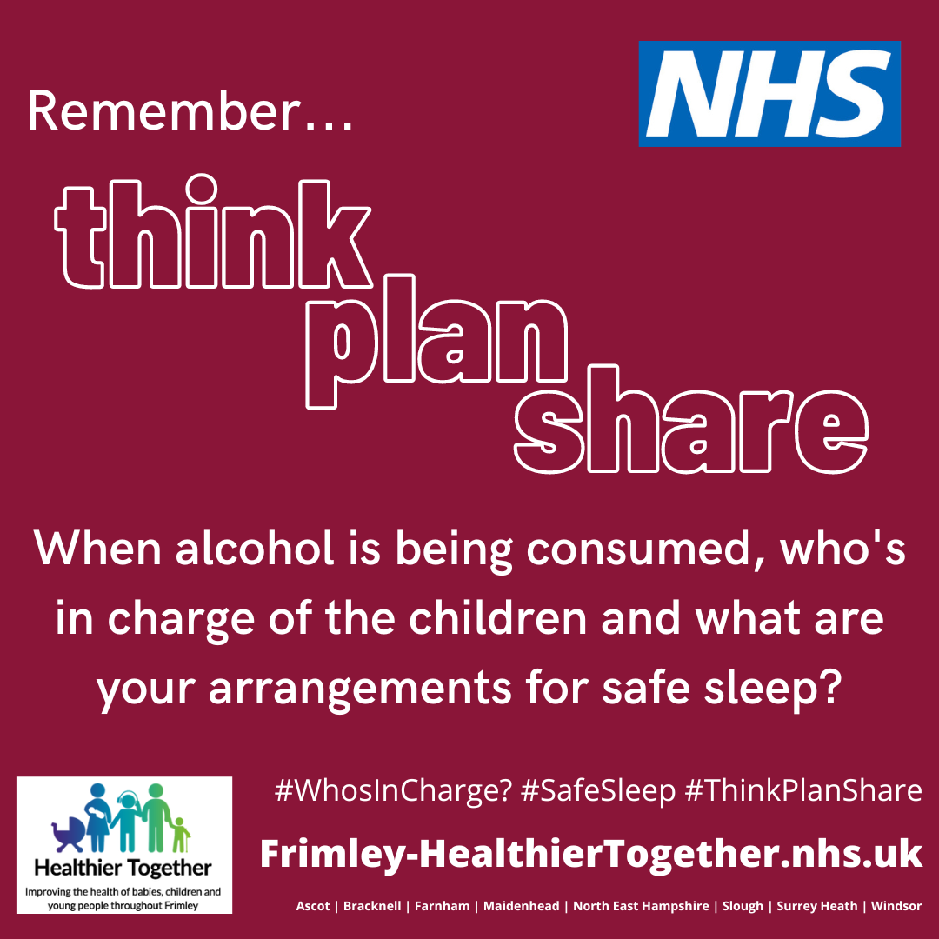
Message twelve for use on Facebook & Instagram
There were 40 cases of infants dying unexpectedly, notified to the Child Safeguarding Practice Review Panel between June 2018 to August 2019.
Unsafe co-sleeping environments, often with parents who had consumed alcohol, was involved in many of these baby deaths.
Remember to think, plan and share what your arrangements for safe sleep are and to establish who’s in charge of your child/ren.
#WhosInCharge? #SafeSleep #ThinkPlanShare
https://bit.ly/3cYdwn6
Source of stat – Death in Infancy Review July 2020.

Slide 18
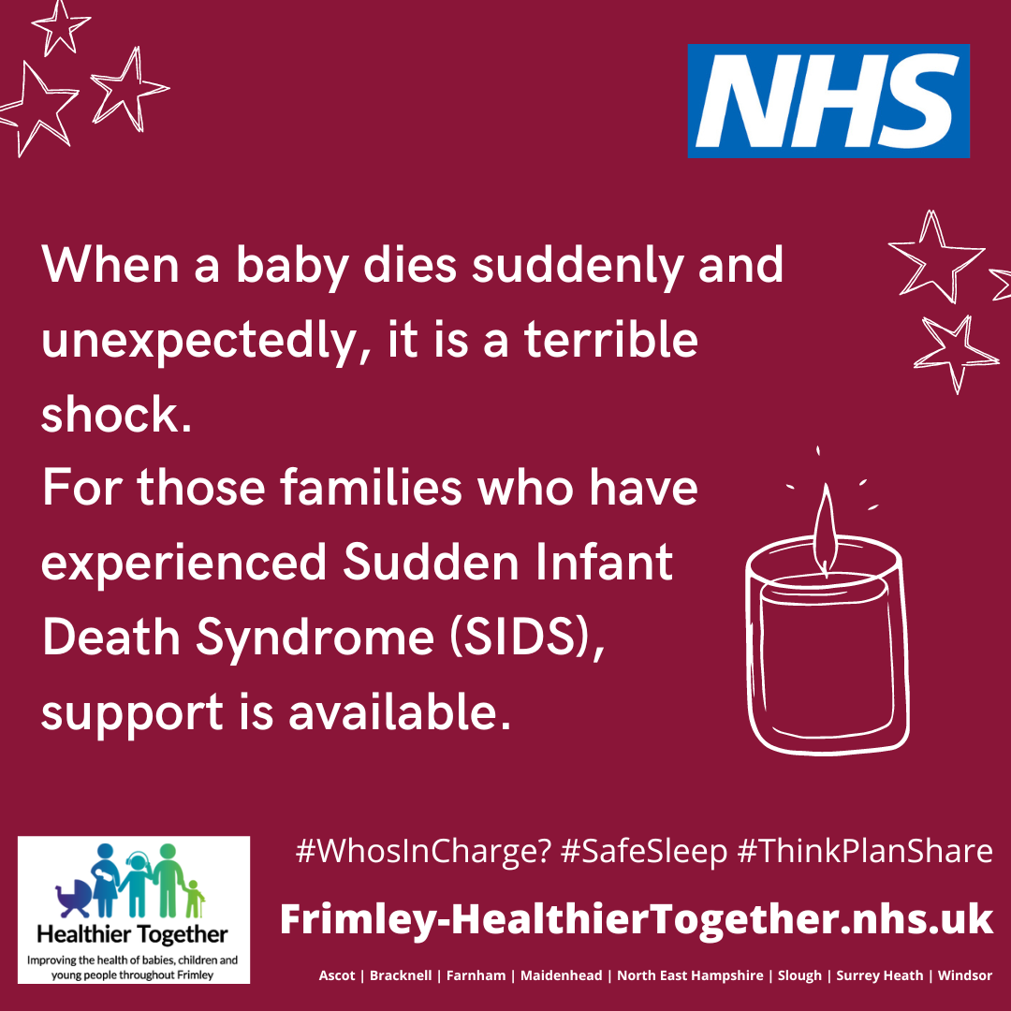
Message thirteen for use on Facebook, Twitter & Instagram
When a baby dies suddenly and unexpectedly, it is a terrible shock.
For those families who have experienced Sudden Infant Death Syndrome (SIDS), support is available.
#WhosInCharge? #SafeSleep #ThinkPlanShare
https://bit.ly/3cYdwn6

Slide 19
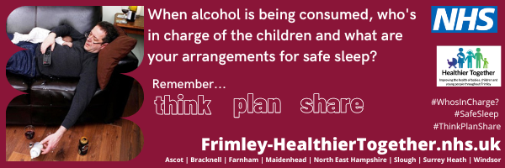
Email signature
Please utilise the email signature below, using the link to the landing page for when people click on the visual.
https://bit.ly/3cYdwn6

